Slide 1

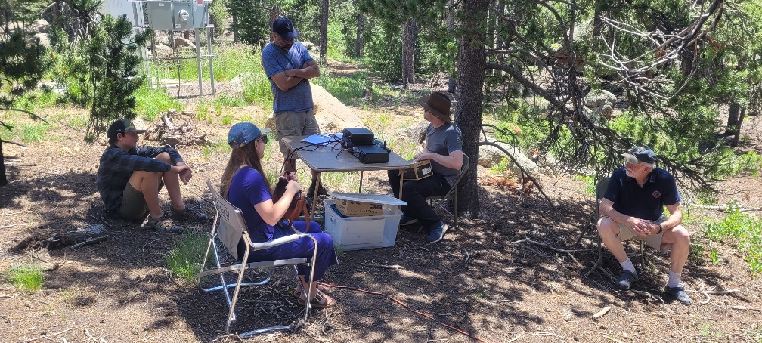
IPRC Field Day 2025 Summary
3,084 total points 2024: 1,714
2023: 1,348 2022:1,128
1,128 QSOs 2024 309
2023: 270 2022: 165
1,109 SSB Contacts (1 point each)
19 Digital Contacts (2 points each)
Bonus points 790
Home Scores Added?

Slide 2
2025 Bonus Points
√ 100 pts/xmtr 100% Emergency Power (4x) 400 total
100 points Media Publicity
100 points Public Location
√ 100 points Public Information Table
100 points Message Origination to Section Manager
10 pts/message Message Handling
100 pts Satellite QSO
100 points Alternate Power
√ 100 points W1AW Bulletin Reception
100 points Educational Activity
100 points Site visit by elected official
100 points Site visit by ARES official
√ 50 points Web submission
√ 40 points Youth participation
100 points Social Media Promotion
√ 100 points Safety Officer Checklist
790 Total Bonus Points

Slide 3
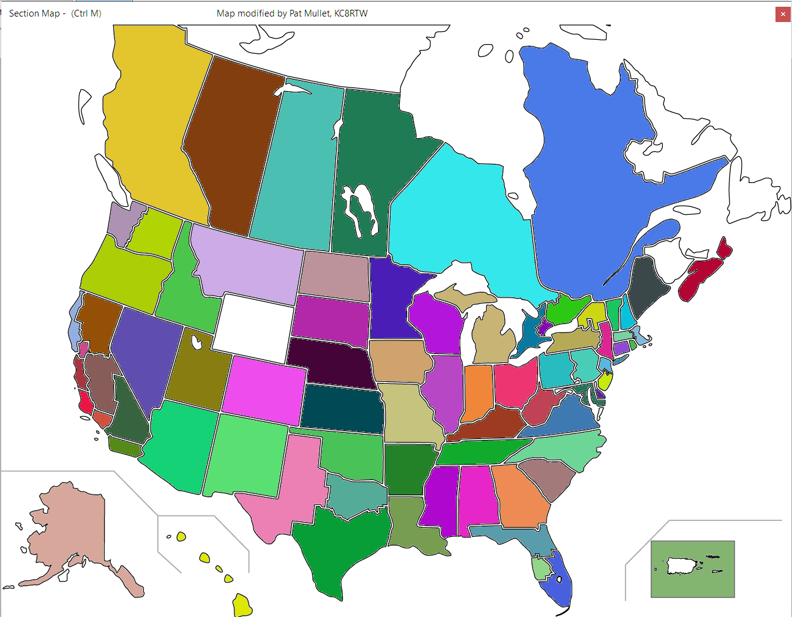
2025 Contact Map

Slide 4
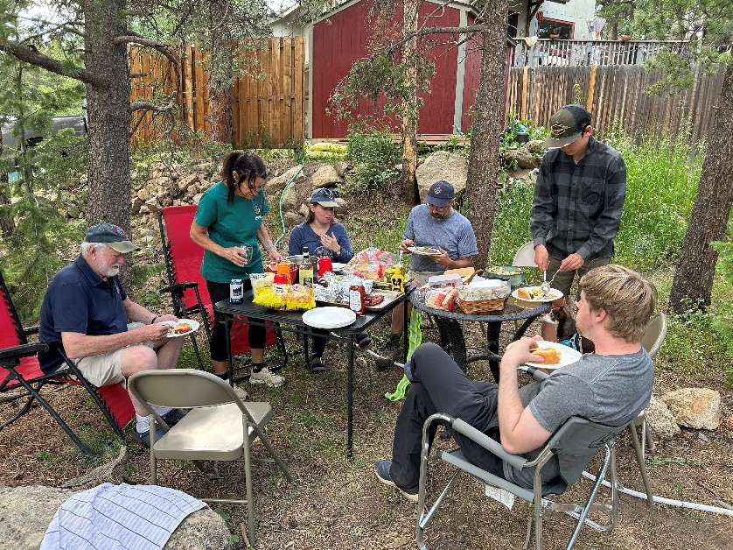
Participants and Visitors
Scott and Debbie
Rob and Madeline and Ameya
Leon and Oscar
Jesse
Matt
Dan
Bar-K Neighbors
Barbie Bills, Hayes, George, Case

Slide 5
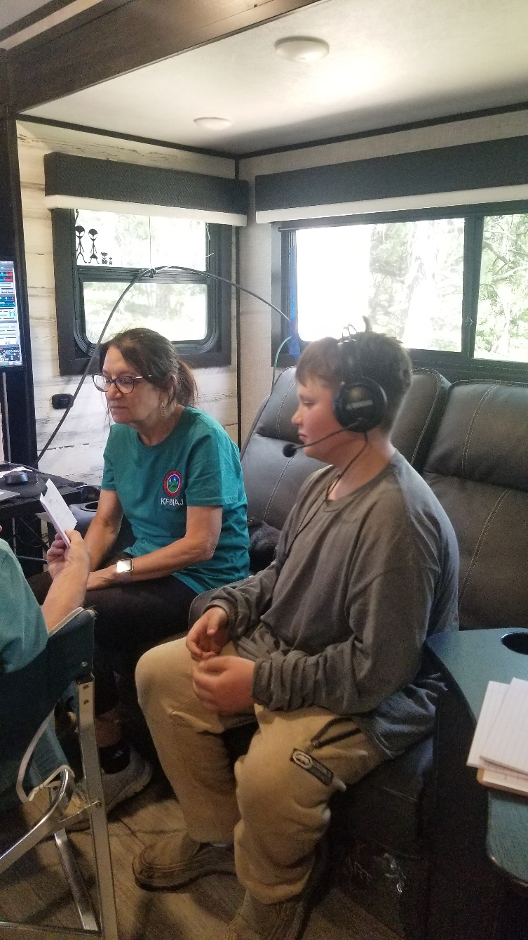
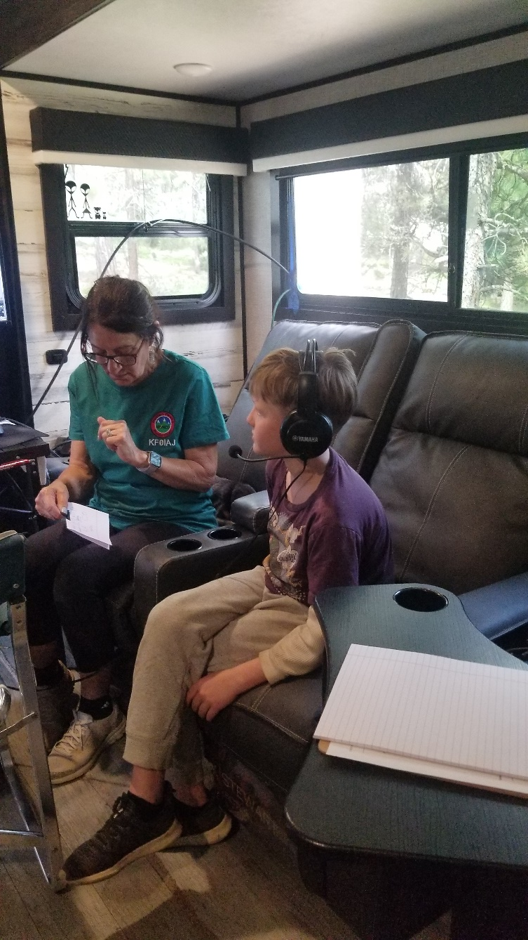
Youth Participants

Slide 6
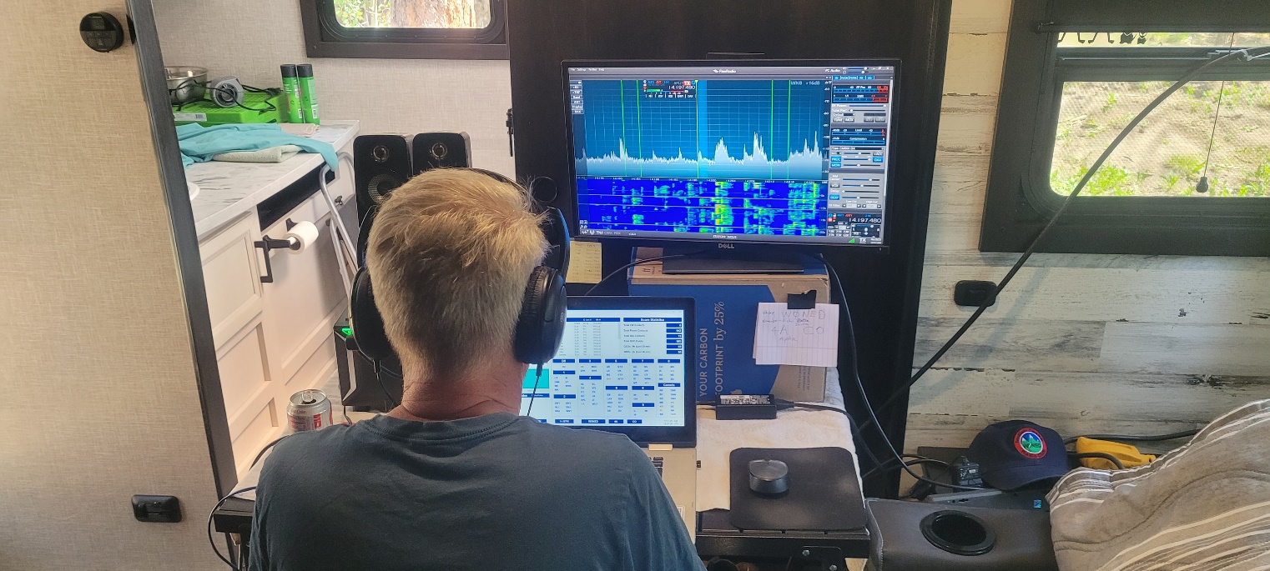
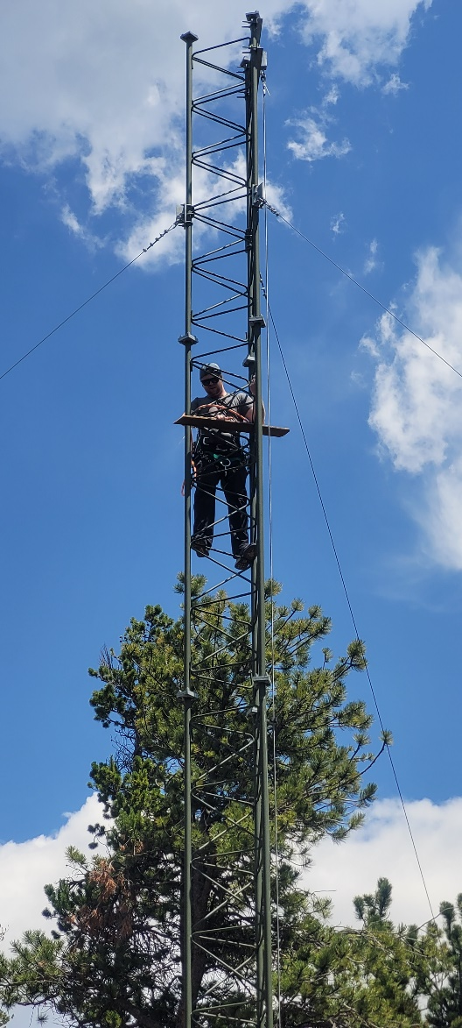
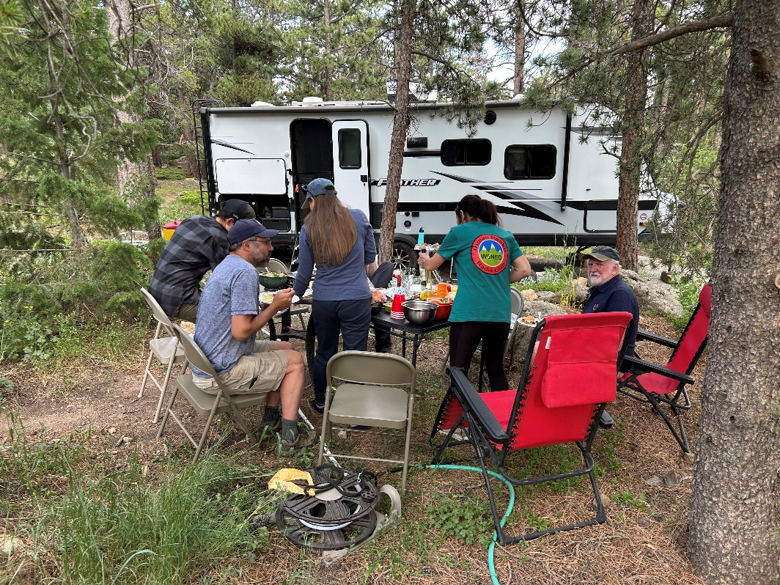

Slide 7
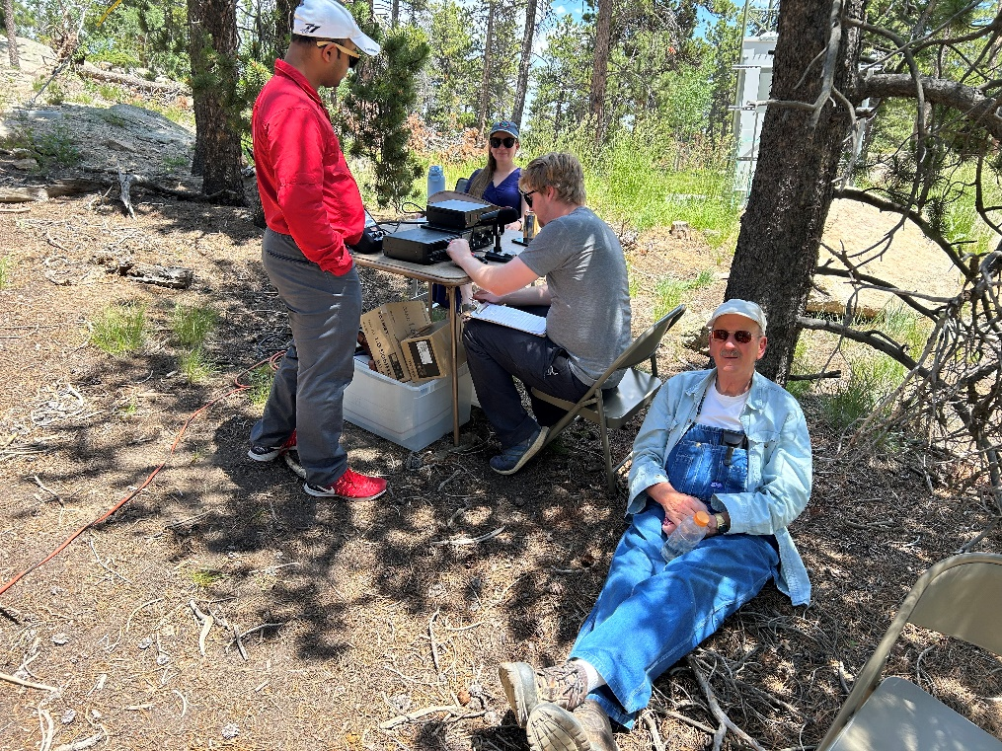
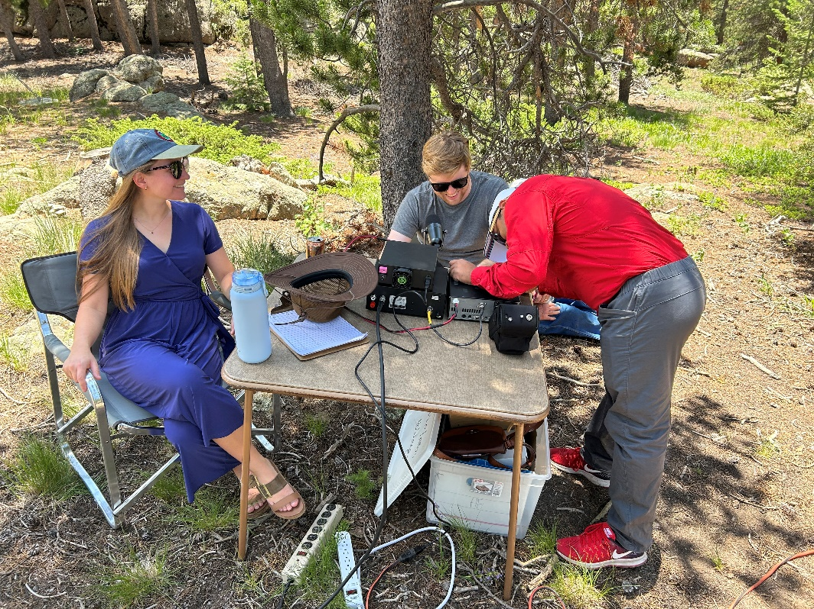

Slide 8
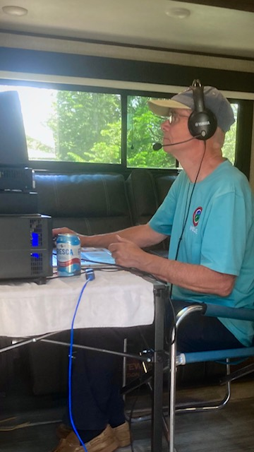
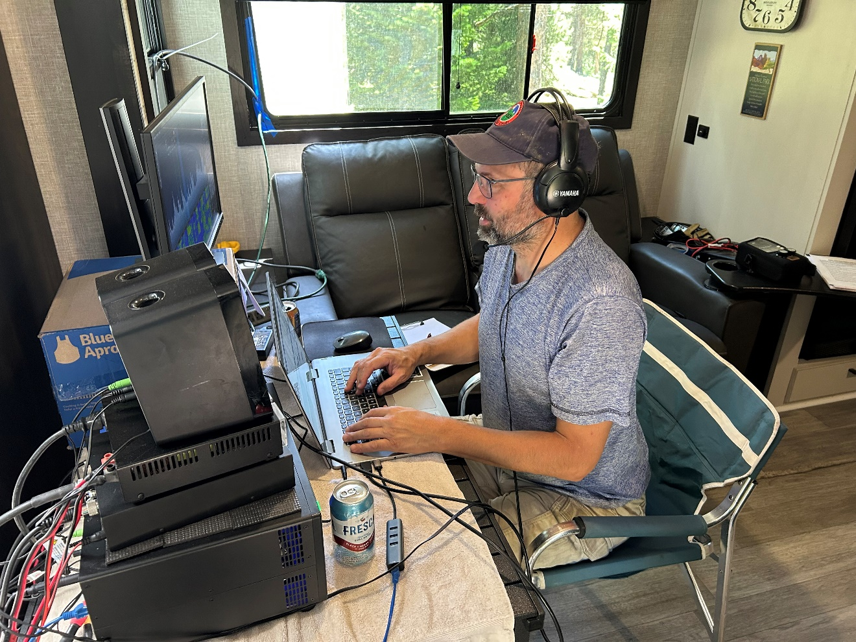

Slide 9
