Slide 1
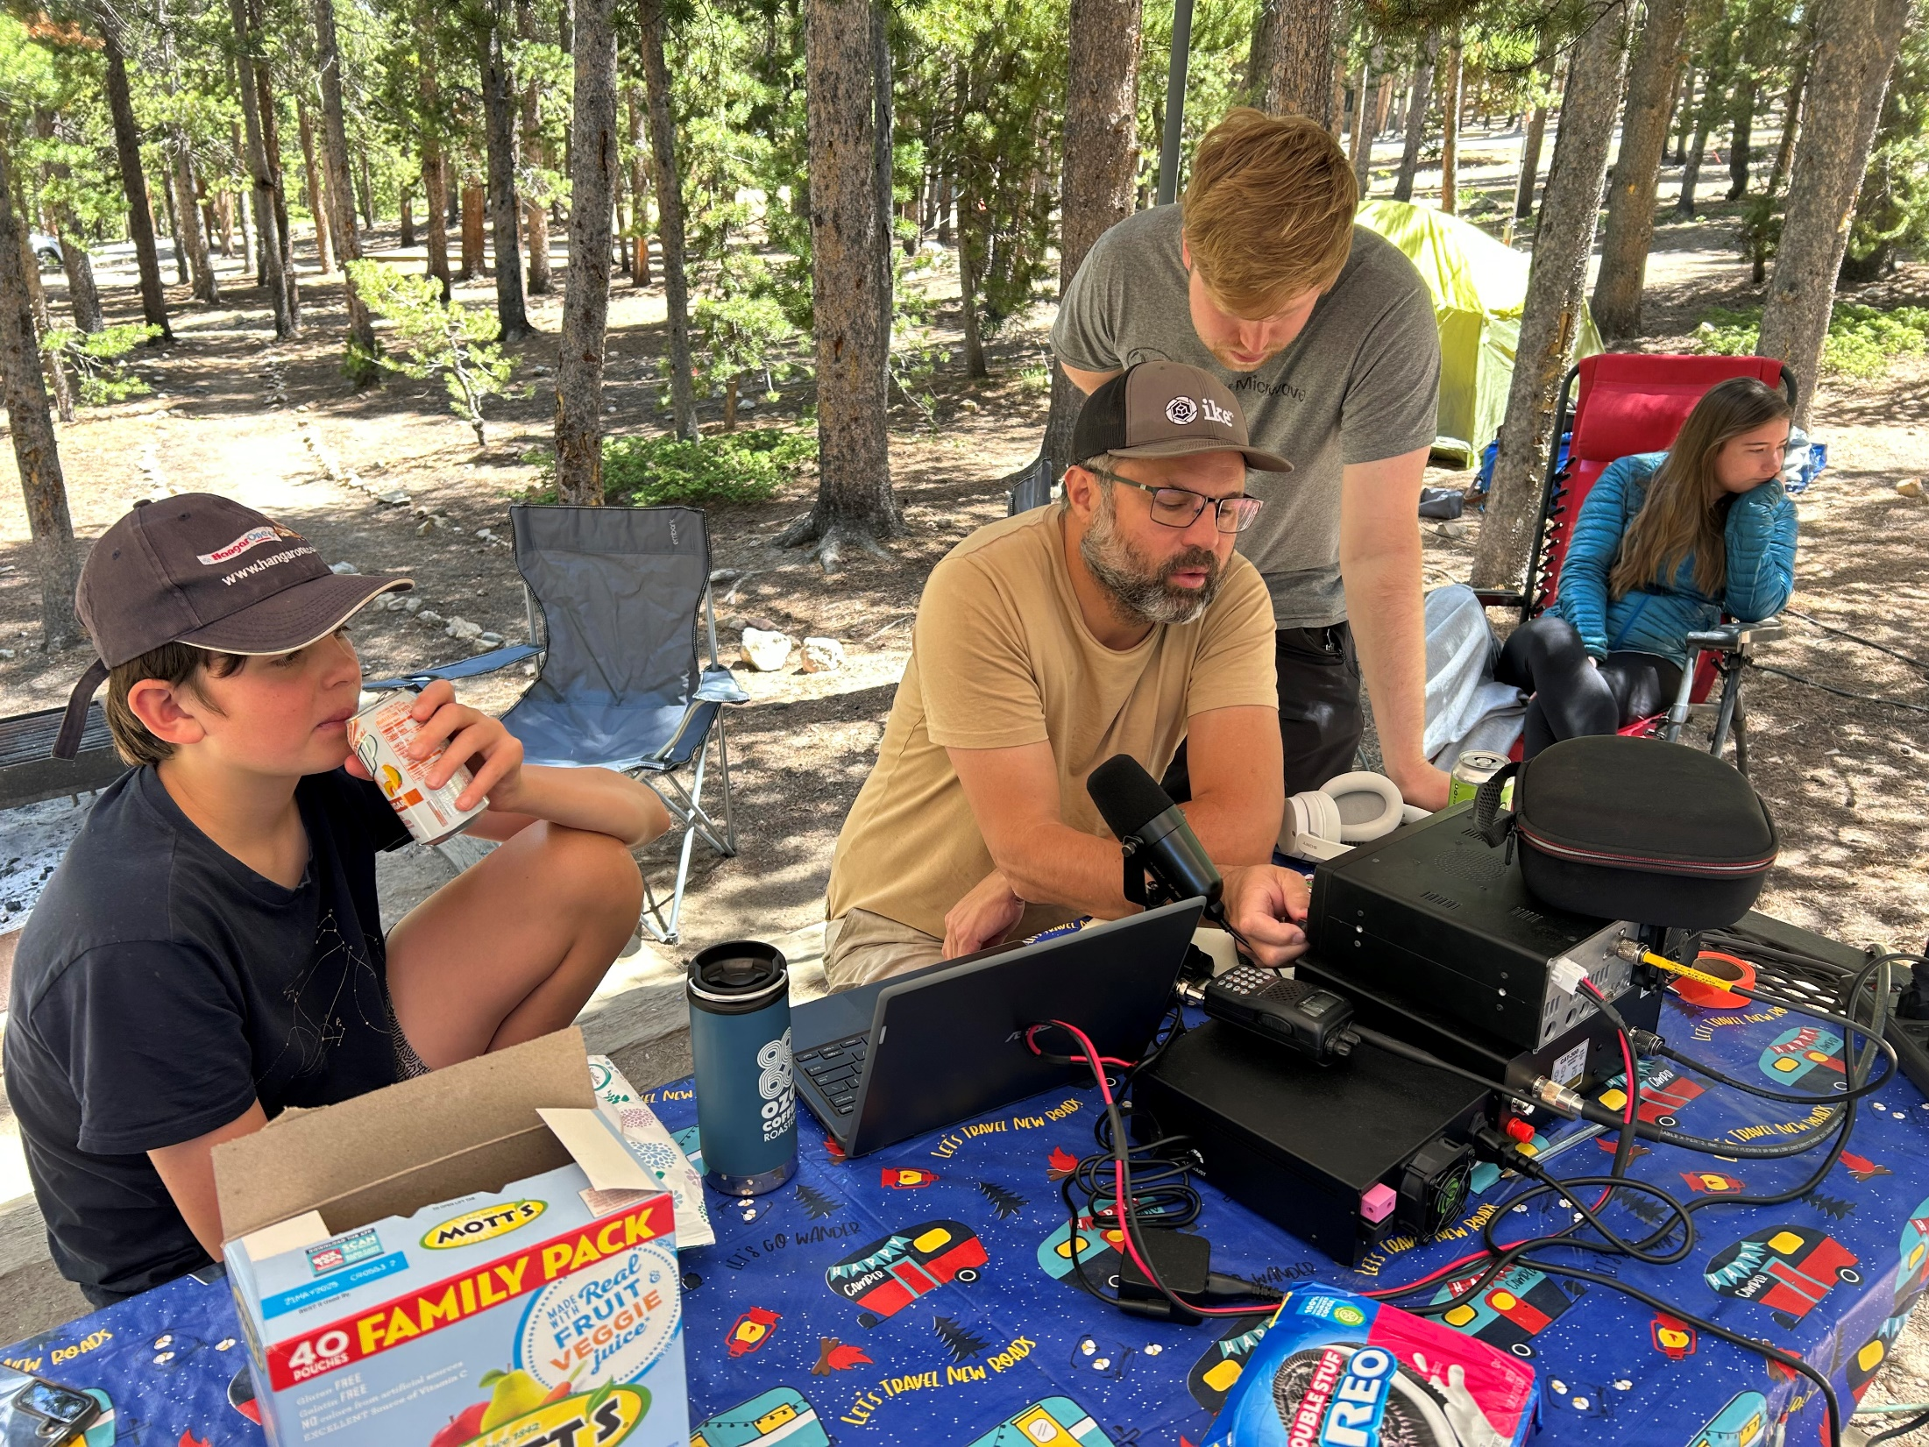
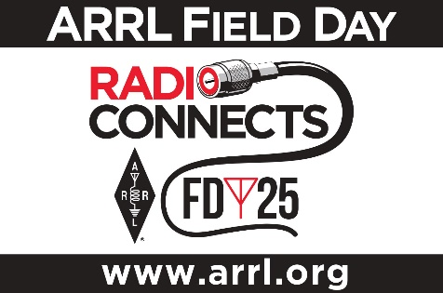
Field Day
IPRC Meeting May 27, 2025

Slide 2
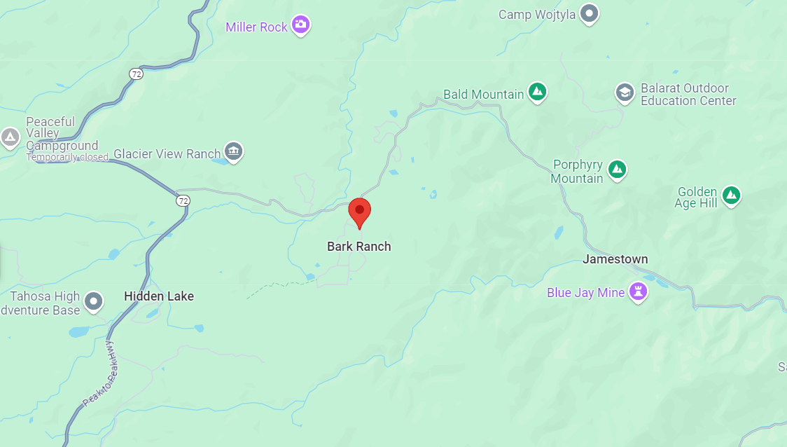
Field Day 2025 Location Bar-K Ranch
Overland Road
(sign: Jamestown)
Peak-Peak Highway

Slide 3
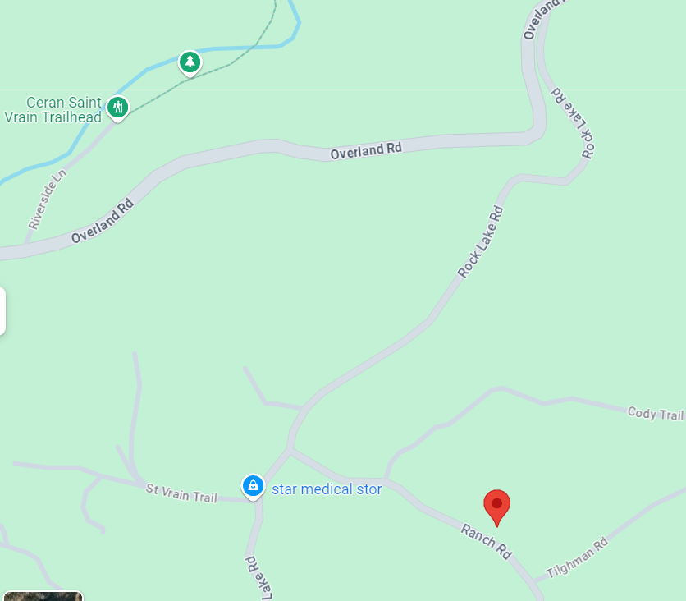
Field Day 2025 Location Bar-K Ranch
Sign:
Bar-K Ranch
(road turns paved)
125 Ranch Road
Ward, CO

Slide 4
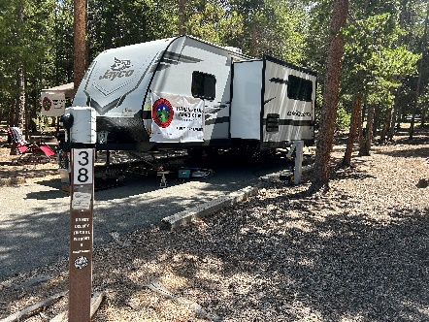
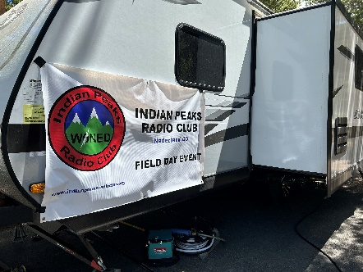
Field Day 2025
Saturday, June 28 – Sunday, June 29
Noon-noon
Objective
To work as many stations as possible
ARRL: “…not contest…” (It sure feels like one)
Learn to operate in abnormal situations in less than optimal conditions
A premium is placed on developing skills to meet the challenges of emergency preparedness as well as to acquaint the general public with the capabilities of Amateur Radio.
Club members not at the site can still add their score to WØNED!
Use your own call
Enter WØNED on submission form

Slide 5
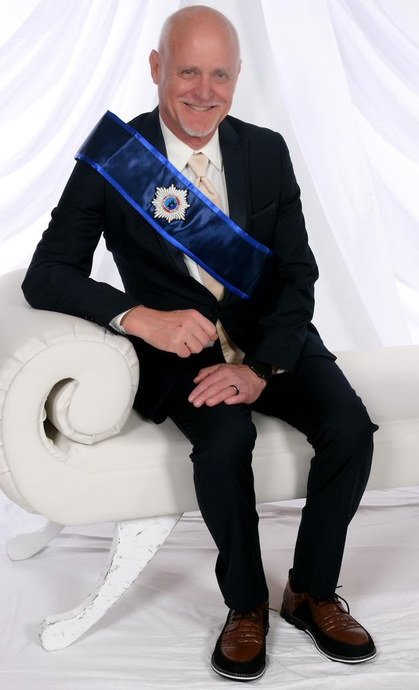
Field Day 2025
Headcount
Must have X transmitters on the air for a portion of the contest (3? 4?)
80, 40, 20, 15, 10, 6, 2 meters (NOT WARC bands)
Can move around bands as needed
Must not be on same band, same mode, same time
Generator power puts us in Class A
Preparation!
Start setup Friday, 6/27 early afternoon
Antennas and Radios
Food

Slide 6
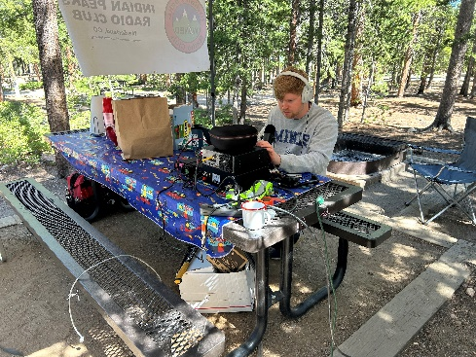
Field Day 2025
Preparation
Use camper as central station
Start setup Friday, 6/27
Use Scott’s existing antennas
Tower hybrid quad for 20-15-10-6 meters
Offset dipole for 80-40
Camper is ~114’ from tower (need coax)
Unused tower on property
Dipole support?
Easy up or coax from camper?
Rob 6m vertical
Matt FT8?

Slide 7
Bonus Points
Attempt 2025
100 pts/xmtr 100% Emergency Power 300 total
100 points Media Publicity
100 points Public Location
100 points Public Information Table
100 points Message Origination to Section Manager
10 pts/message Message Handling
100 points Satellite QSO
100 points Alternate Power (5 QSOs, can be battery charge)
100 points W1AW Bulletin Reception (PSK31)
100 points Educational Activity
100 points Site visit by elected official
100 points Site visit by ARES official
50 points Web submission
Up to 100 points Youth participation
100 points Social Media Promotion Facebook
100 points Safety Officer Debbie KFØIAJ

Slide 8
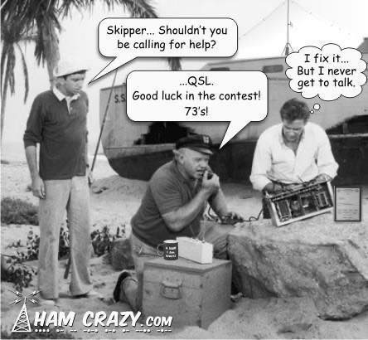
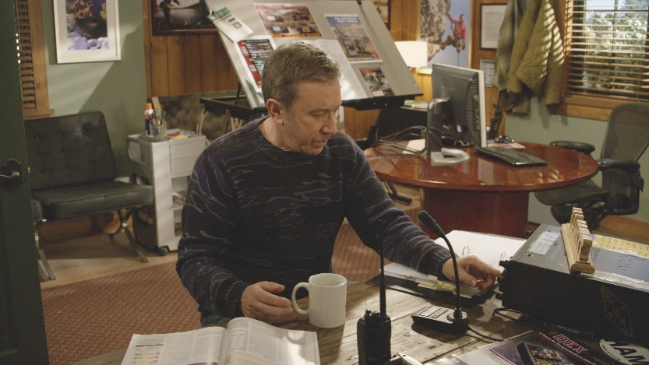
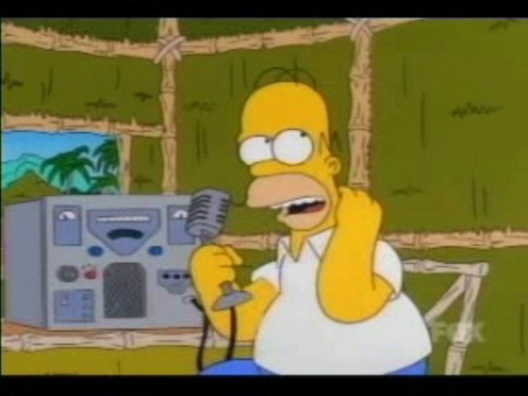
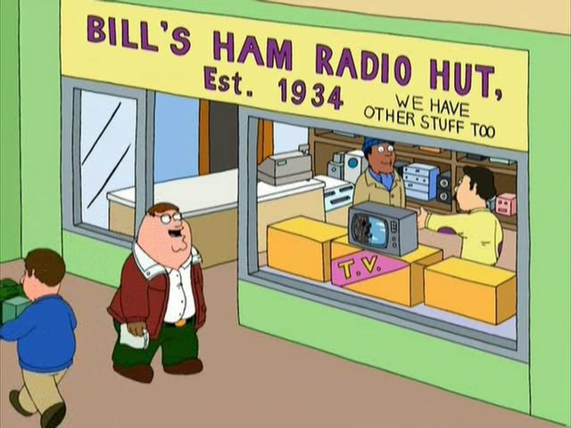
CQ Field Day!
More People, More Fun!
Come on out, if only for a while…

