Slide 1
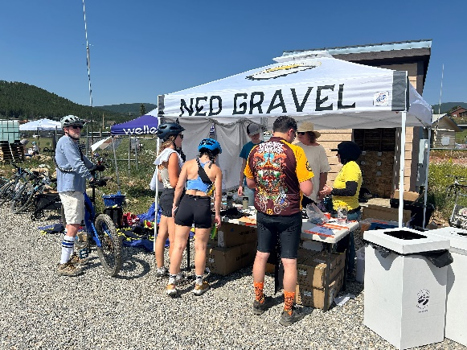
IPRC Ned Gravel 2024 Summary
July 13, 2023 (Saturday)
Hot day. Water was an issue.
Checkpoints
Net Control (Guercio): Scott W0SJE, Rob KE0SOW
Mammoth Gulch: Tom, KD5ZDT
Missouri Gulch: Rick, KK0COP
Switzerland Trailhead: Matt KD0PYK
Gold Hill: Don, K0DBL
Gold Run Rd. / 4 Mile: Ben, KF0OKA

Slide 2
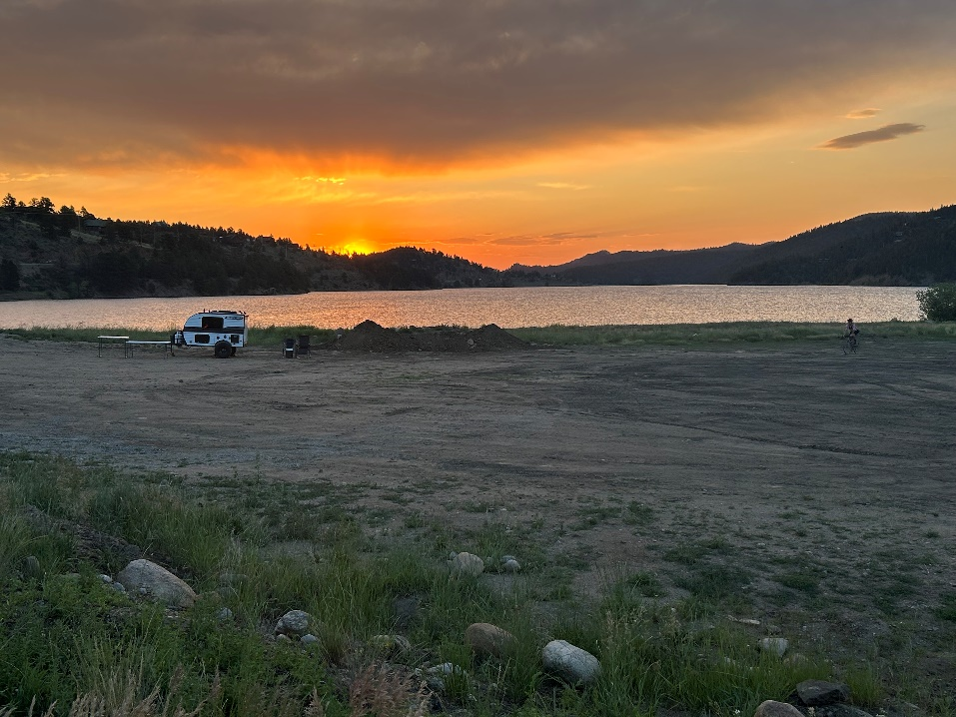
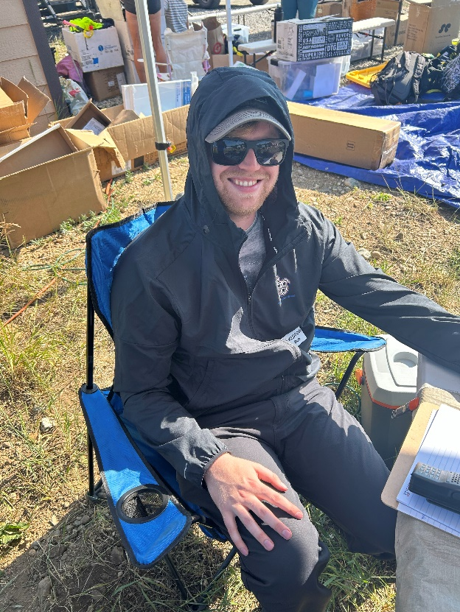
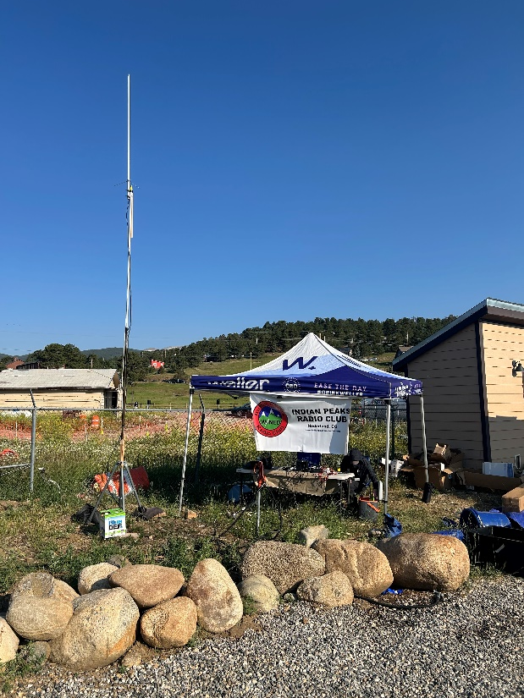

Slide 3
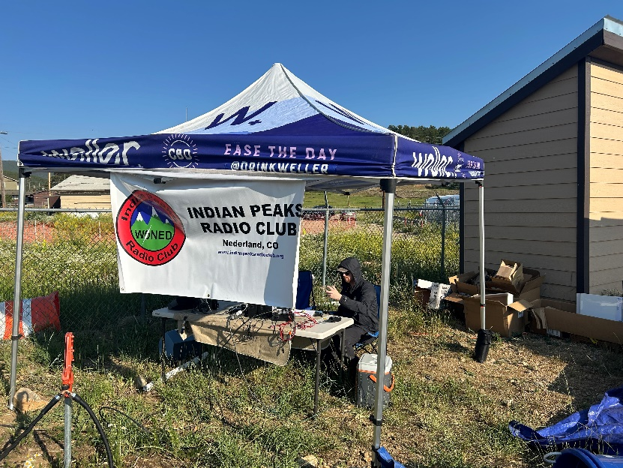
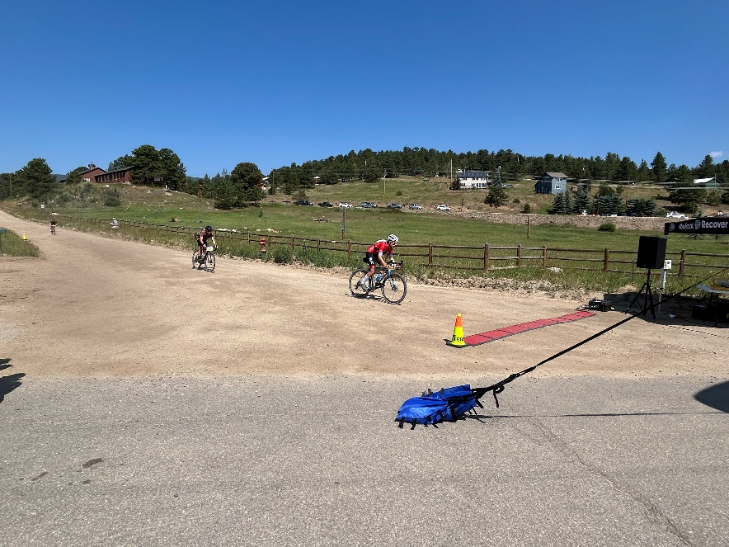
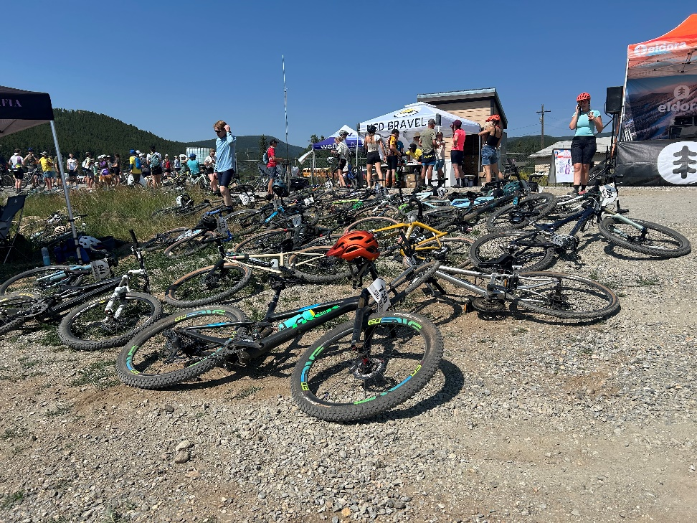

Slide 4
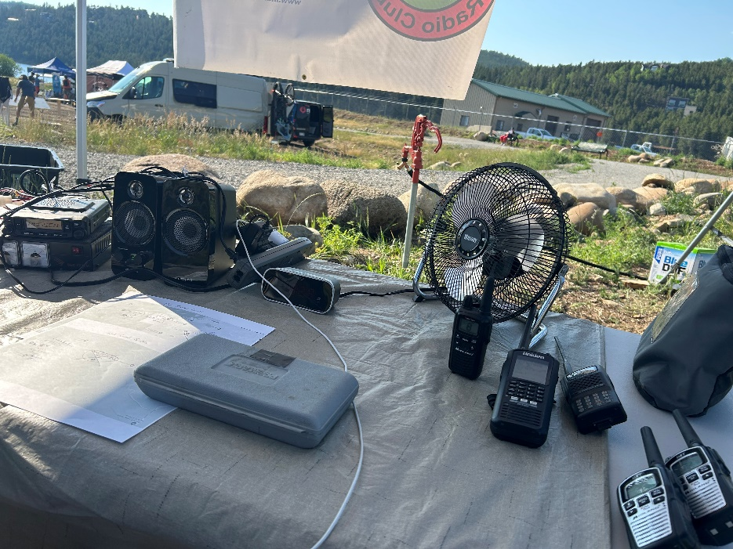
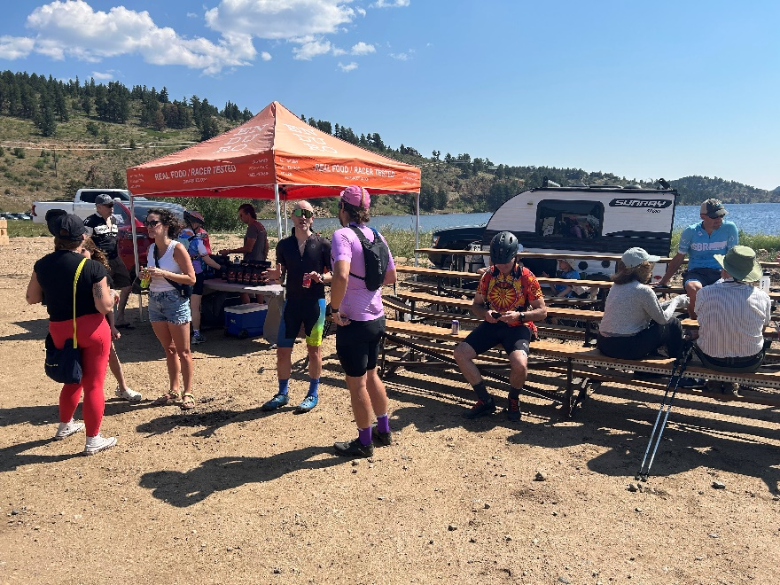
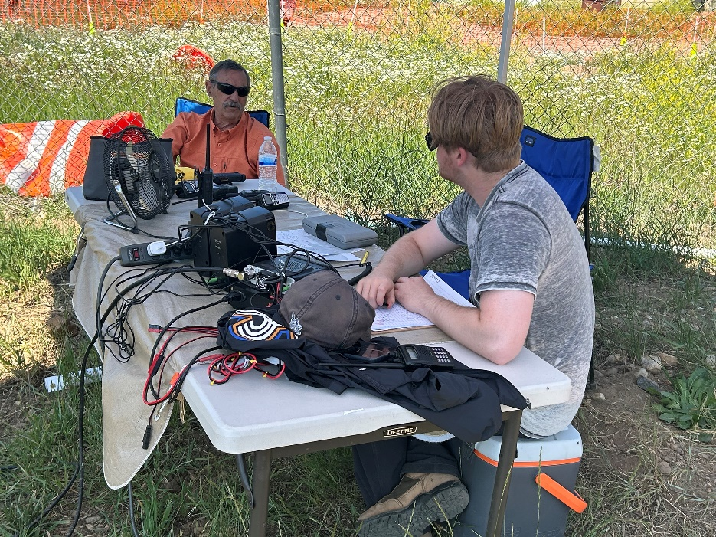
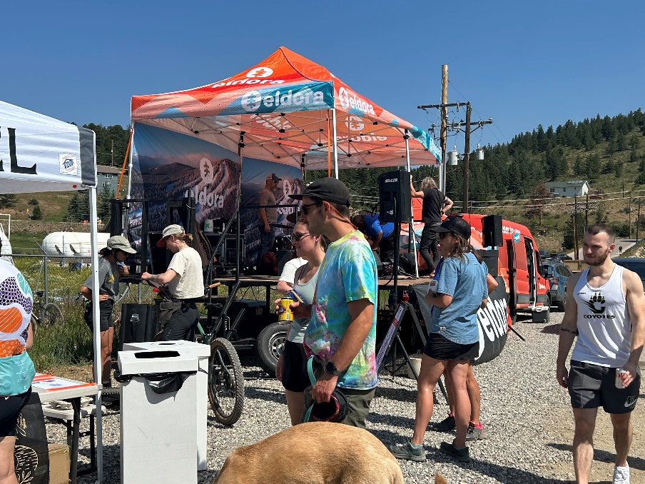

Slide 5
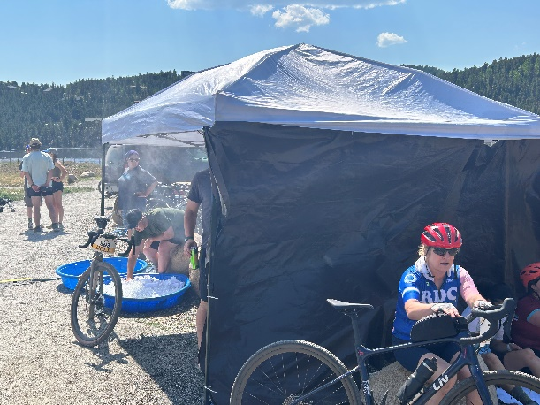
IPRC Ned Gravel Event Recap
Ultra rider count confirmed by Rick at Missouri Gulch
Early crash of 5 riders handled by medical and relayed to net control
1 rider taken by ambulance; bike and wallet missing
Water transferred between checkpoints

Slide 6
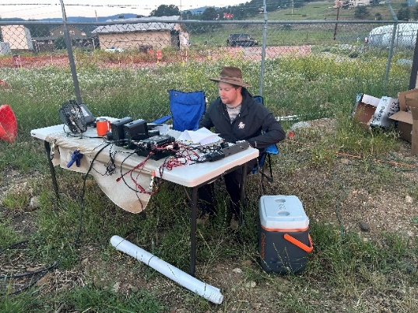
IPRC Ned Gravel Notes
Radio coverage was as expected
W0NED
Airlink
My Comments
2 shifts for long duration checkpoints
Net control
Switzerland Trailhead
Fresh operators for late rider status
Medical staff coordination needs work
Club member with their rover?
Noise from music and announcements
Bring 2 headphones and splitter
Rider confusion at Sawmill / Switzerland Trail
Flagger direction vs. signage

Slide 7
IPRC Ned Gravel Notes
Participant comments
Rob KE0SOW
Move net control next to medical
More coordinated checkpoints with aid stations
Tom, KD5ZDT
Rick, KK0COP
Matt KD0PYK
Don, K0DBL
Gold riders signage issue. Riders in opposite directions. Boulder Co. sheriff on site was helpful.
Ben, KF0OKA
1 injured rider. Course map would be helpful. Bear encounter resolved quickly.

