Slide 1
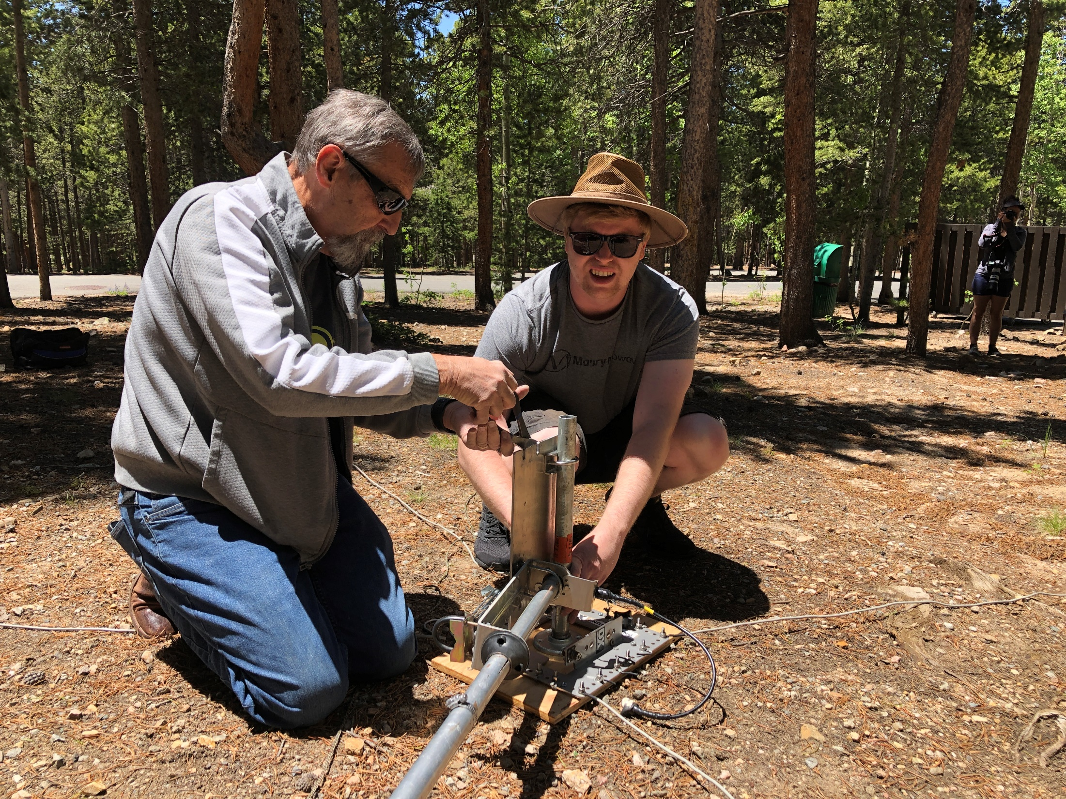
Field Day
IPRC Meeting April 23, 2024

Slide 2
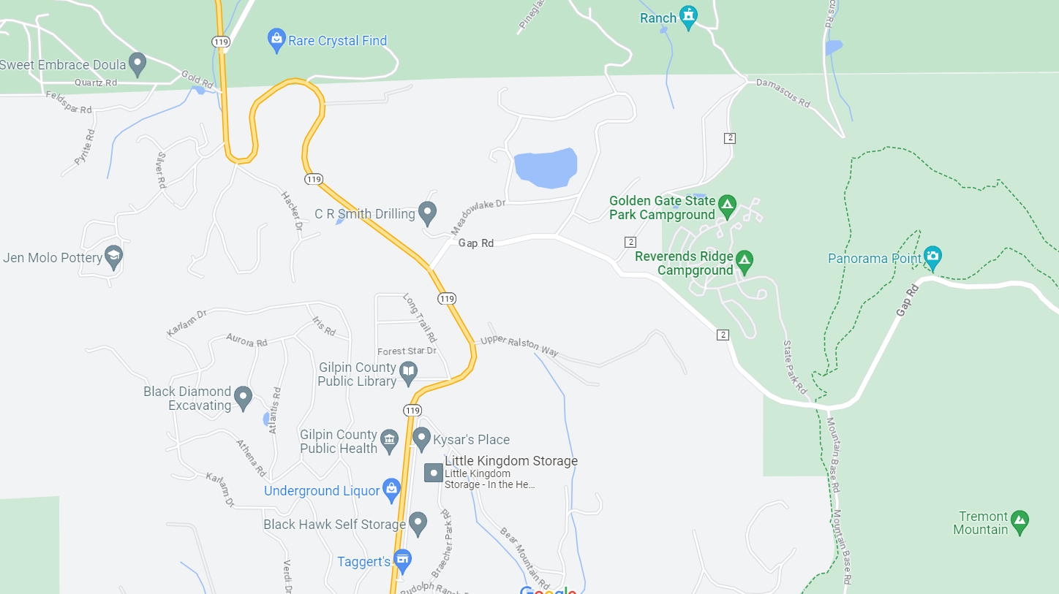
Field Day 2024 Golden Gate Canyon State Park
Lat 39.87612
Long -105.44963
Campground
(Park Fee $10)
Access from 119 to
Gap Road
Some Cell
Phone Coverage
No RVs on
Mountain Base Road

Slide 3
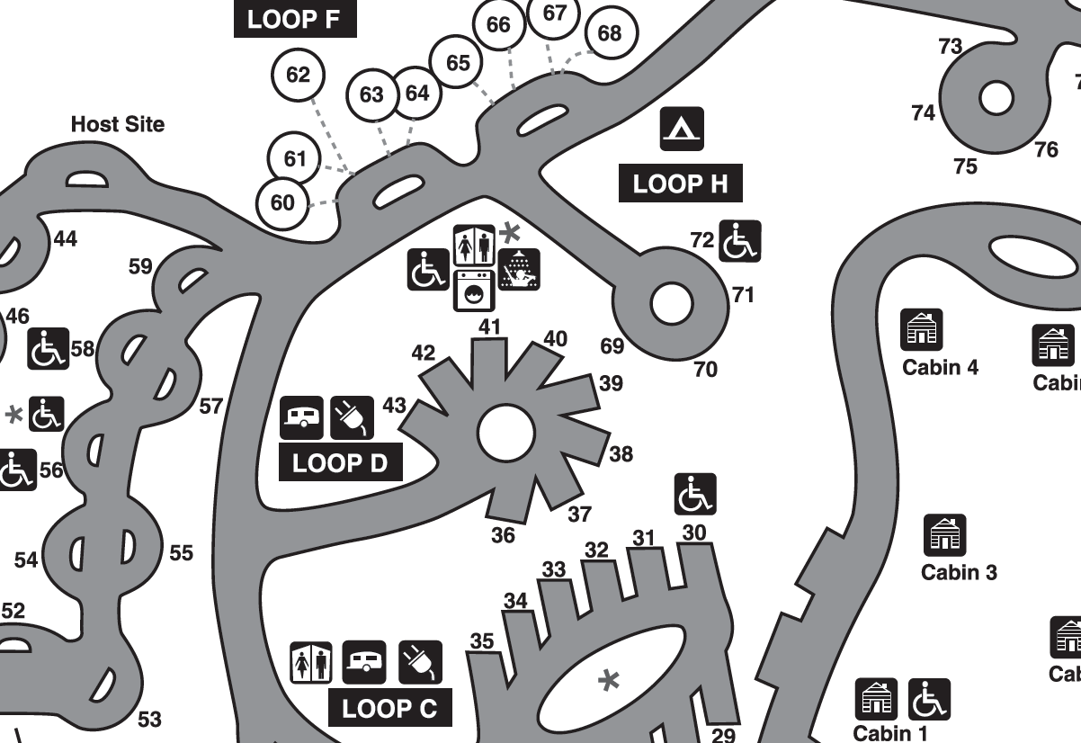
Field Day 2024

Slide 4
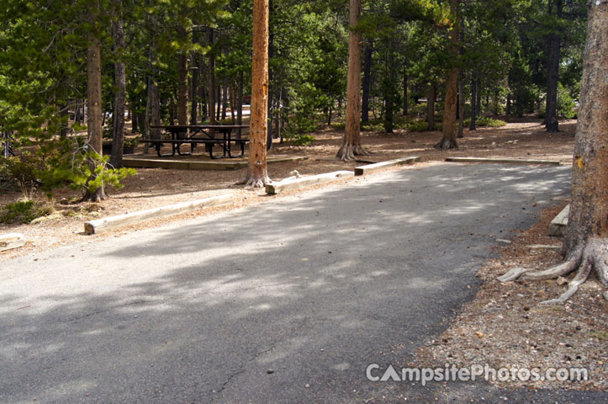
Field Day 2024; Site 38

Slide 5
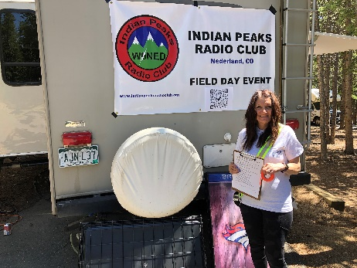
Field Day 2024
Saturday, June 22 – Sunday, June 23
Noon-noon
Objective
To work as many stations as possible
ARRL: “…not contest…” (It sure feels like one)
Learn to operate in abnormal situations in less than optimal conditions
A premium is placed on developing skills to meet the challenges of emergency preparedness as well as to acquaint the general public with the capabilities of Amateur Radio.
Club members not at the site can still add their score to WØNED!
Use your own call
Enter WØNED on submission form

Slide 6
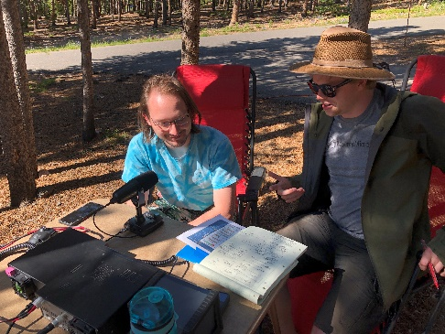
Field Day 2023
Headcount
Must have X transmitters on the air for a portion of the contest
80, 40, 20, 15, 10, 6, 2 meters
Can move around bands as needed
Must not be on same band, same mode, same time
Location
Golden Gate Canyon State Park
Use Gap RoadEntrance for Reverand’s Ridge Campground; Site 38; Loop D
Fee $10
Start setup Friday, 6/21
“…tying off to trees is prohibited…”
Supports for wire antenna ends?
Use verticals

Slide 7
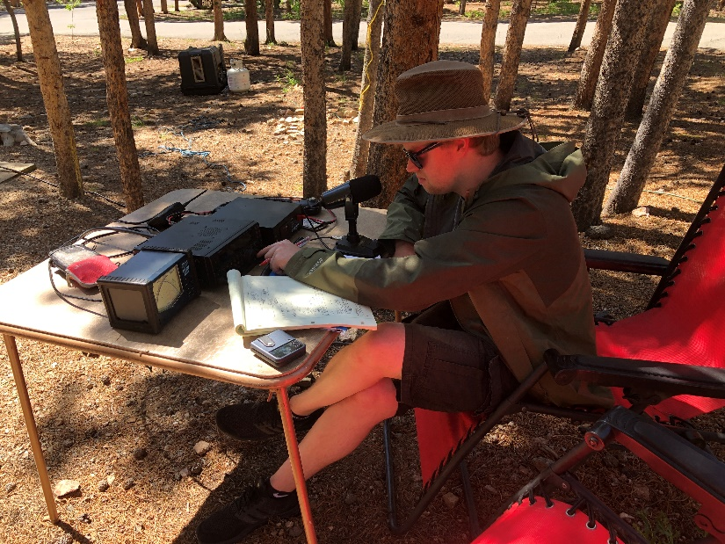
Field Day 2024
Campground Facilities
RV and tent(s) at each site
Restrooms
120V power pole
Showers
Take into account
No cell service at site 38
Limited at Panorama Point
Rick has offered his Starlink – Wifi calling!
Helps FT8 timing too
We will have neighbors (batteries at night for class A)
We will have neighbors (promote ham radio!)

Slide 8
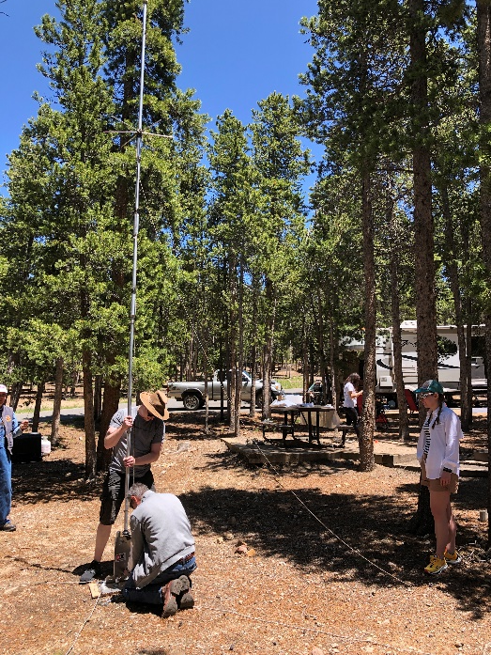
Field Day 2024
We have a 30’ trailer available with extra bed
Generator with quiet enclosure
FT-847 and Flex-6400
Hamstick antennas, 20m dipole
Club G5RV
Other Rigs / Antennas?
Power sources
Batteries, batteries, batteries
Solar for bonus?
Need CW Operators!
2 points/contact vs. 1 for phone!
Food Plan
Log using N3FJP Program
Club call, PW 35350
Talk-In WØNED repeater – confirmed coverage!
Simplex (146.500)

Slide 9
Bonus Points (need owners)
Attempt 2024
100 pts/xmtr 100% Emergency Power 300 total
100 points Media Publicity (Thoughts?)
100 points Public Location
100 points Public Information Table
100 points Message Origination to Section Manager
10 pts/message Message Handling?
100 pts Satellite QSO
100 points Alternate Power (5 QSOs, can be battery charge)
100 points W1AW Bulletin Reception
100 points Educational Activity
100 points Site visit by elected official
100 points Site visit by ARES official
50 points Web submission
Up to 100 points Youth participation
100 points Social Media Promotion Facebook
100 points Safety Officer Debbie KFØIAJ

Slide 10
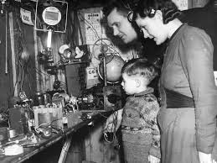
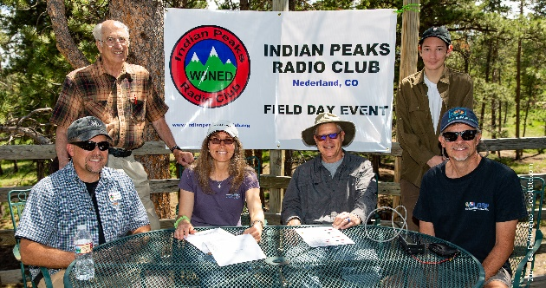
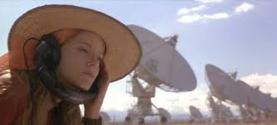
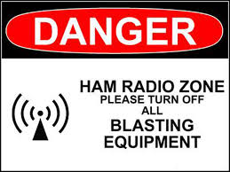
CQ Field Day!
More People, More Fun!
Come on out, if only for a while…

