Slide 1
IPRC Ned Gravel 2023
July 8, 2022 (Saturday)
5 checkpoints and net control in Ned
Some checkpoint changes from 2022
Bring up map
Rover?

Slide 2
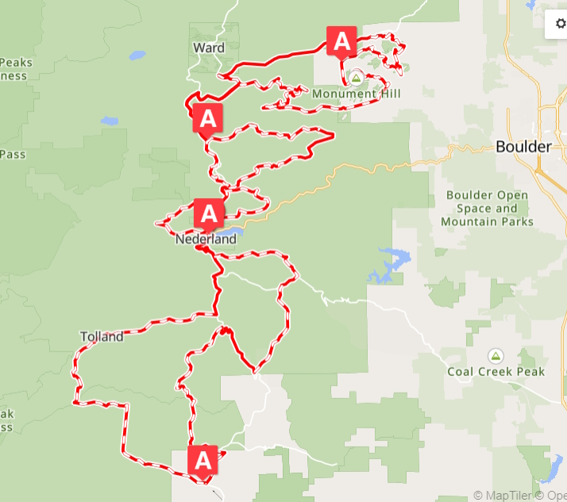
Course Summary

Slide 3
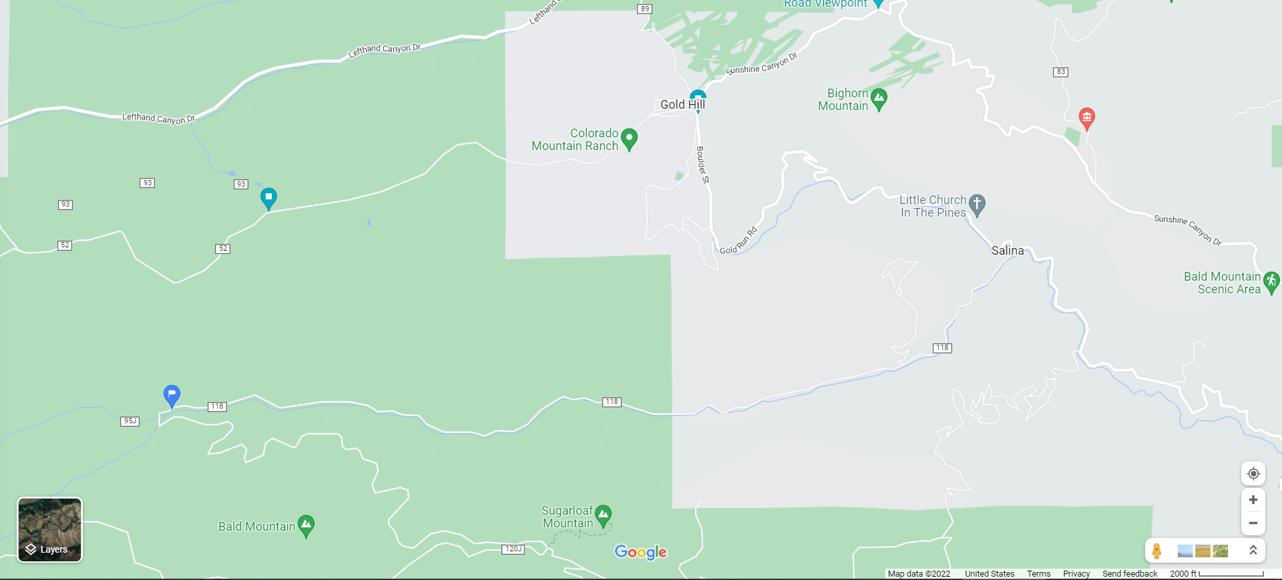
North of Ned 2022
Switzerland Trailhead Relay
(Rick)
Mt. Alto Relay
(Matt)
4 mile Canyon Dr.
Sunset
(Bill)

Slide 4
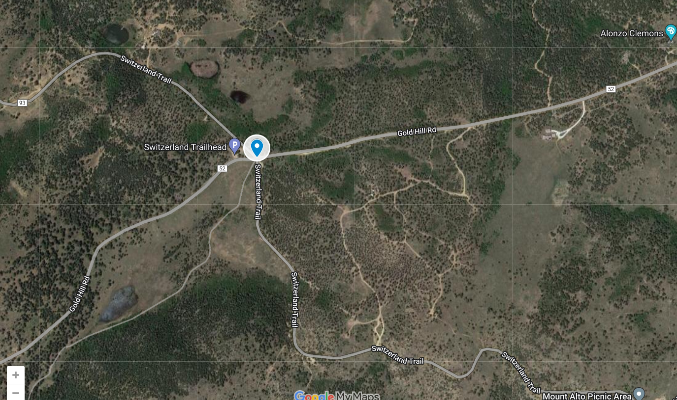
North of Ned 2023
(radio/medic 3)

Slide 5
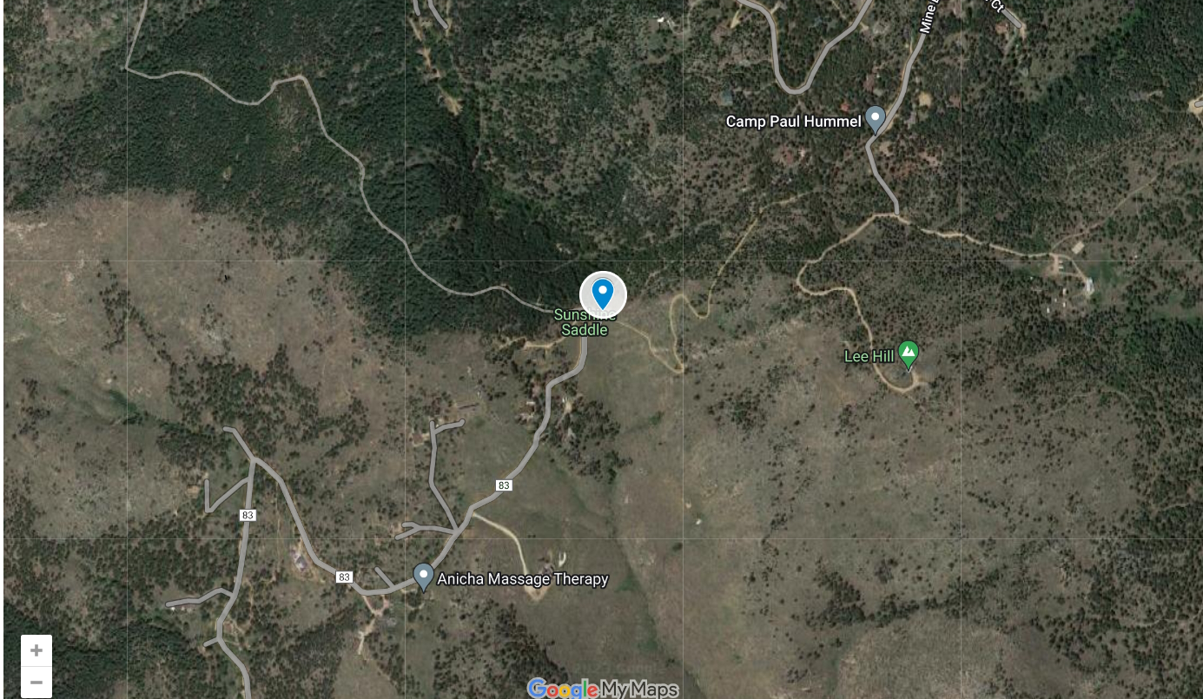
North of Ned 2023
(radio/medic 3a)

Slide 6
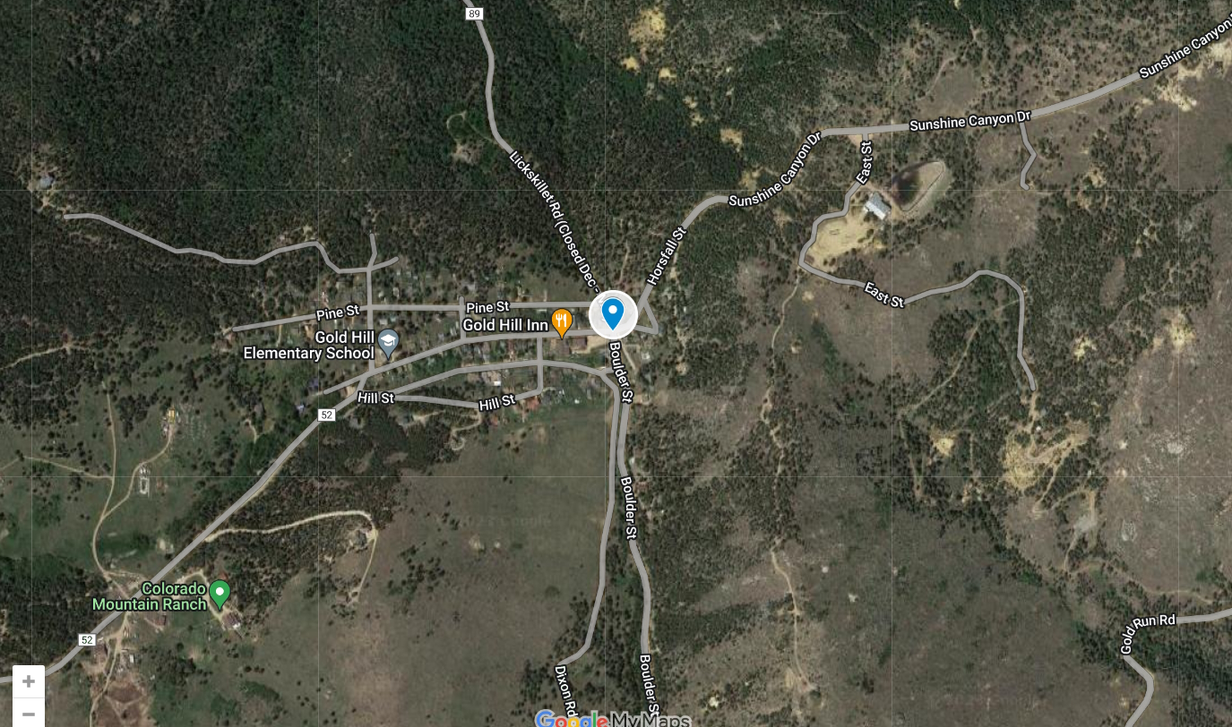
North of Ned 2023
(radio 4)

Slide 7
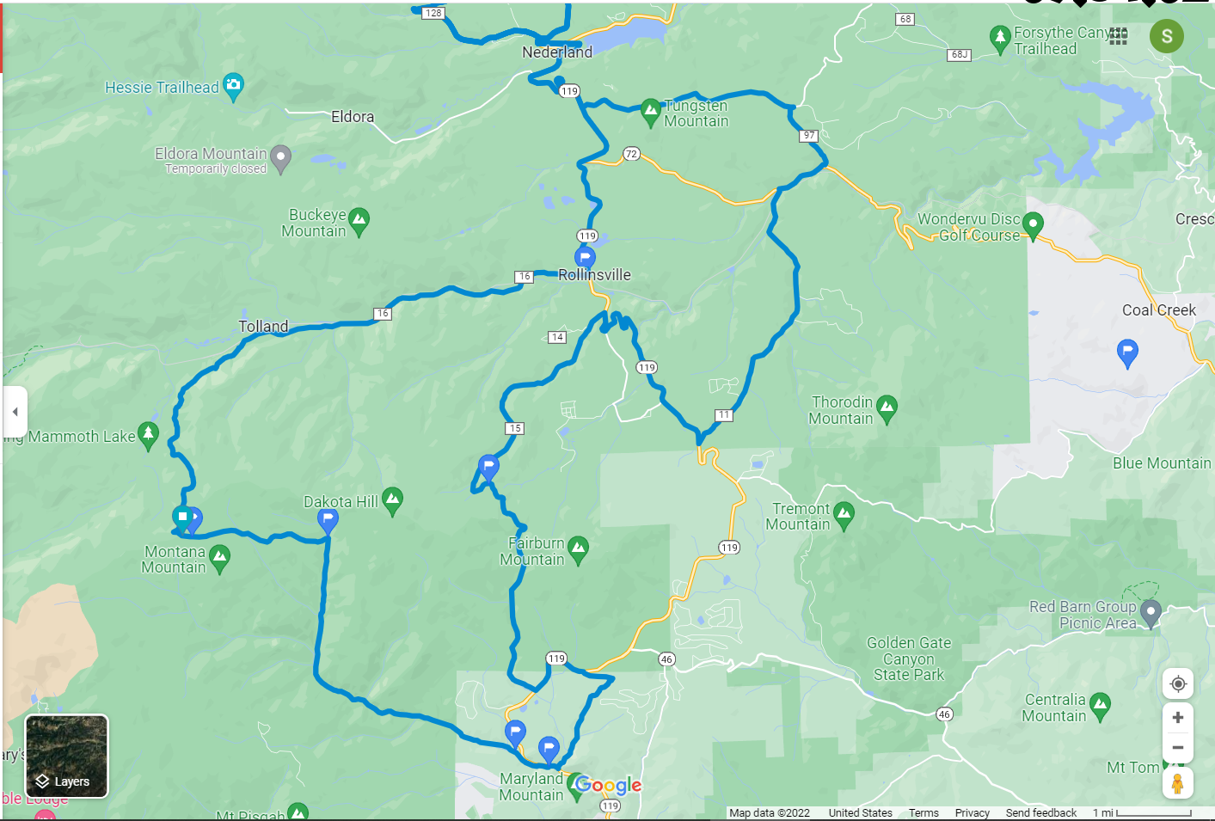
South of Ned 2022
Rover 1 (Charlie)
S Beaver Creek Rd.
Rd. 4-N
Gamble Gulch
(Rob, Jesse)
Mammoth Gulch
(Raman)
Juniper
Apex Valley Rd.
Hughesville
Apex (Rick)

Slide 8
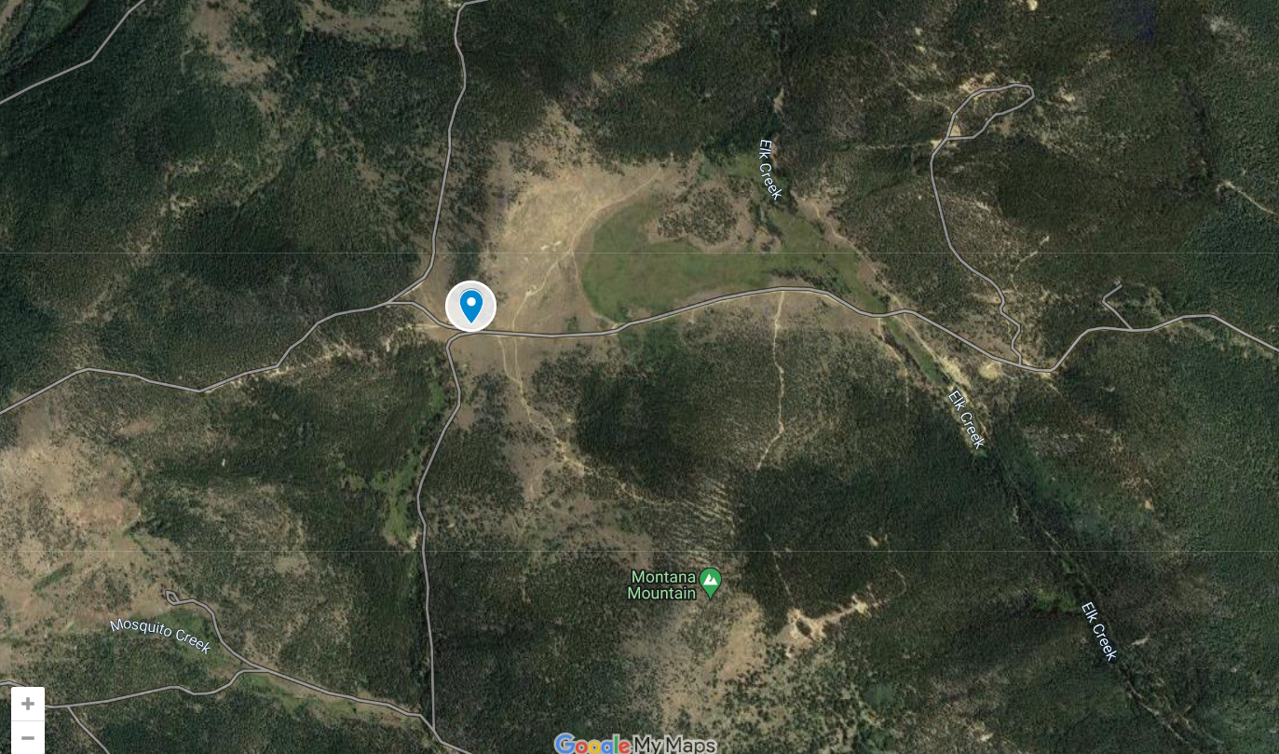
South of Ned 2023
(radio/medic 1)

Slide 9
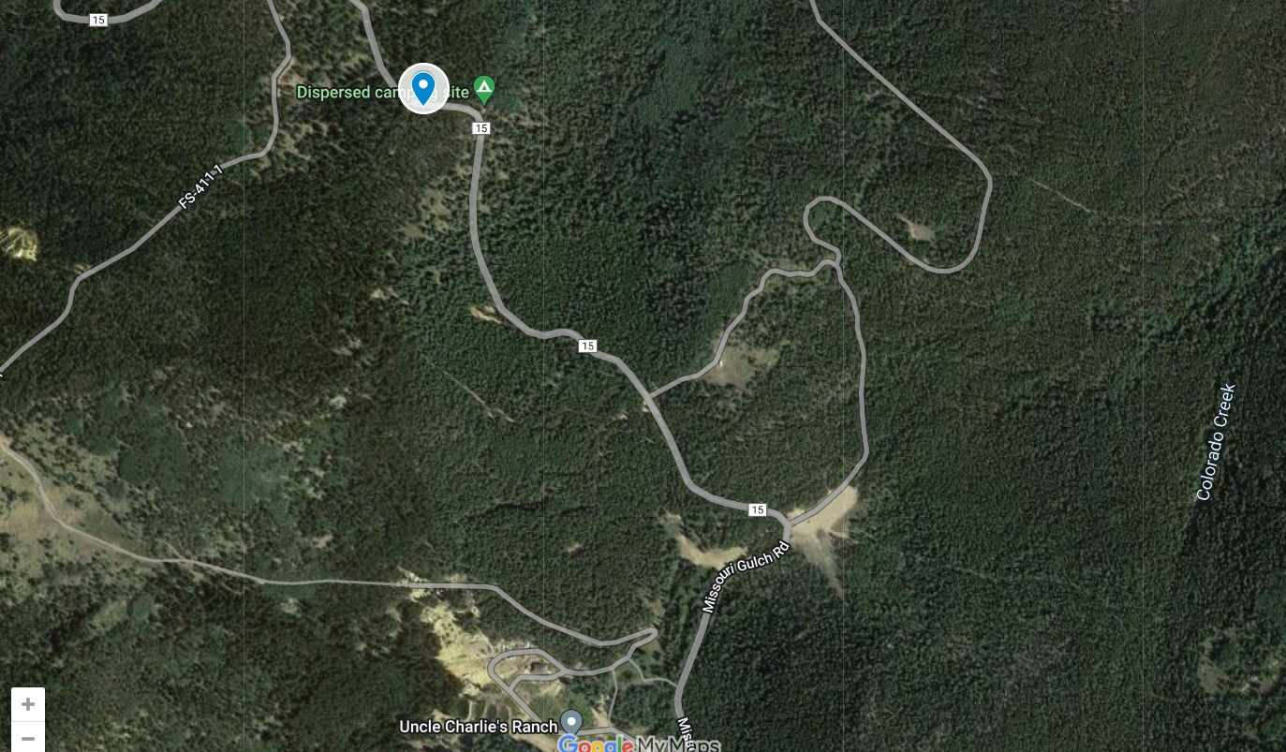
South of Ned 2023
(radio 2)

Slide 10
IPRC Ned Gravel Support
Prime Repeater
Thorodin transmit 448.225; -5 MHz; 141.3 Hz should serve most of the race course.
Receiver votes between Thorodin and Squaw
Backup Repeater
WØNED
Have a station monitoring both repeaters for relays
Checkpoint Callsigns

Slide 11
Expectations
Ned Gravel Expectations
Provide Net Control Area (Tent/table, power, etc)
We will provide all volunteers with a free meal/beer after your shift. (come down to Guercio Field)
Provide “Emergency Communication Support” flyer for vehicles

Slide 12
Expectations
IPRC Expectations
Communicate all medical to Race HQ
When located at an aid station, communicate first rider in and last rider out
Assist in communicating out emergency information to riders (weather/wildlife/etc)
Arrive on time and maintain post till instructed to leave
No expectations to assist riders with mechanical issues
No expectations to count riders unless willing to?
No expectation to work at aid stations

Slide 13
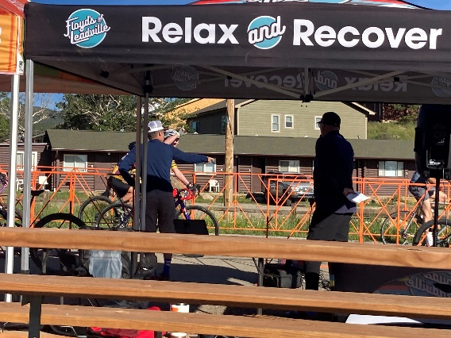
IPRC Ned Gravel 2022
Everyone on station and ready to support early. Thanks!
Sunset was a challenge (as expected). Rick and Matt provided good relays
Rider counts were difficult with racers on course without placards
Several riders not prepared with water
Riders needing transportation due to exhaustion or equipment failure
Flat tires on Switzerland Trail
Rider #49 was never in the race

Slide 14
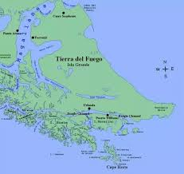
IPRC Ned Gravel Comments
2022
Sunset: Bill, Matt, Rick
Checkpoints have more water
Better antennas at Sunset
Gamble Gulch: Rob, Jesse
Some late timing
Use RFID reader?
Mammoth Gulch: Raman
Thanks for the video!
Reassignment after finished at post
Apex: Rick
Charlie: Rover 1
Better vehicle for rough parts of the course
Have water and other supplies for riders

