Slide 1
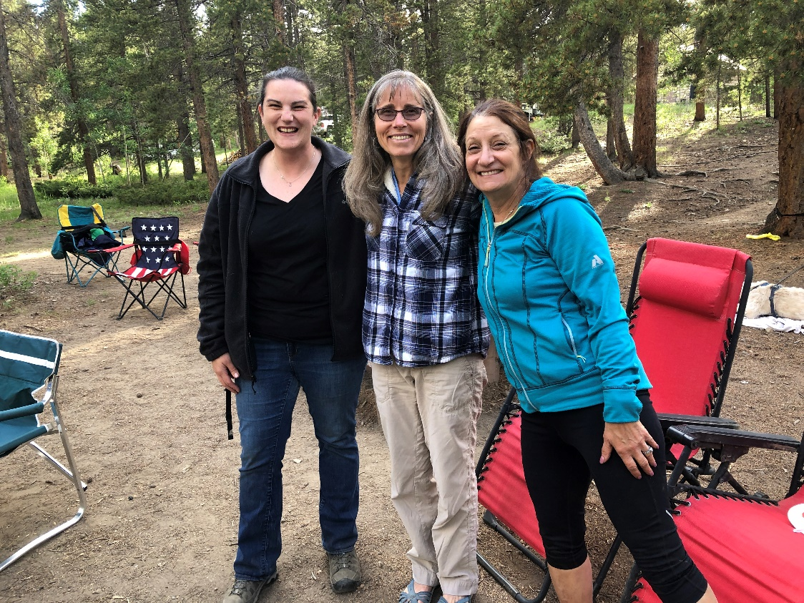
Field Day
IPRC Meeting May 22, 2023

Slide 2
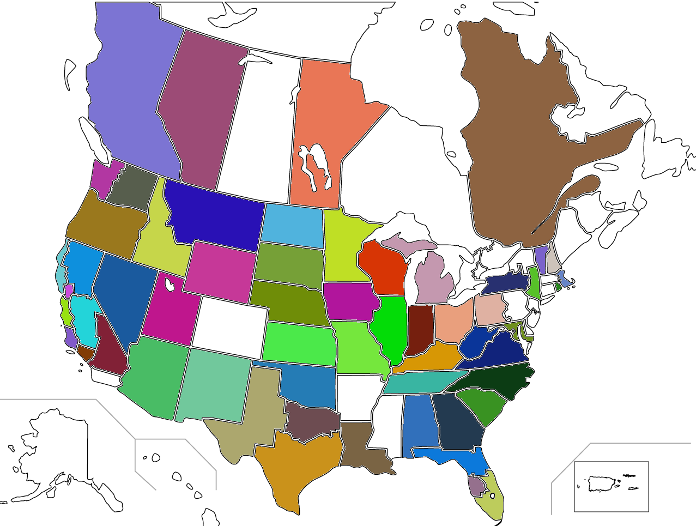
Field Day 2022 Recap
Location: Columbine Campground near Central City
Class 3A
Coverage:

Slide 3
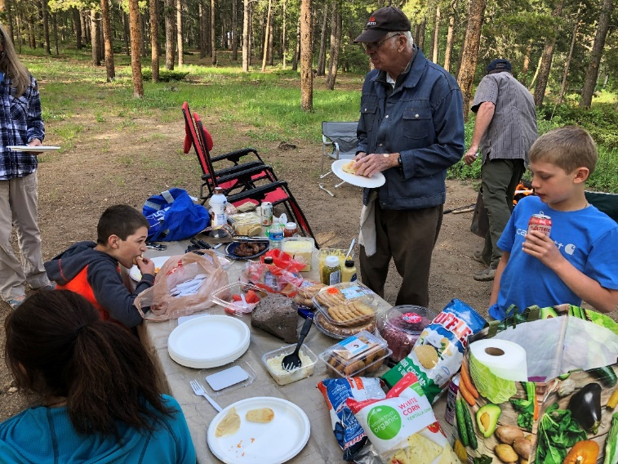
Field Day 2022 Score Recap
1,128 total points 2021: 1,406 (-278)
Bonus points 790 2021: 550
159 SSB Contacts 2021: 428
80 0 2021: 7
40 82, 1 dig 2021: 56
20 75, 5 dig 2021: 299
15 0 2021: 25
6 2 2021: 41

Slide 4
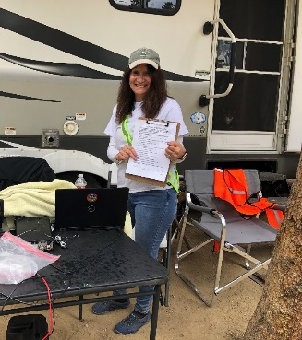
2022 Bonus Points Recap
Claimed
Attempted
Not eligible
Try Another Year
√ 100 pts/xmtr 100% Emergency Power (3x) 300 total
√ 100 points Media Publicity Mountain Ear
100 points Public Location
√ 100 points Public Information Table
100 points Message Origination to Section Manager
10 pts/message Message Handling
100 pts Satellite QSO
100 points Alternate Power
100 points W1AW Bulletin Reception partial copy
100 points Educational Activity
100 points Site visit by elected official
100 points Site visit by ARES official
√ 50 points Web submission
√ 40 points Youth participation (2x20)
√ 100 points Social Media Promotion Facebook
√ 100 points Safety Checklist (Class A)
790 Total Bonus Points

Slide 5
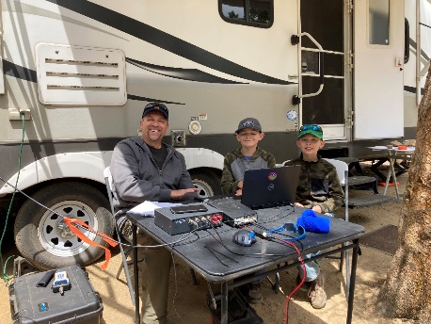
2022 Feedback
Went Well
Antenna setup went well
Site had plenty of room and trees for antennas
Paper “cheat sheet” helped for the exchanges
Social aspect was great and food contributions
Improvements
Build/buy standard club antennas for next year
Include lat/long of location
Try a location with better cell coverage
Investigate MRS for 2023
Book adjacent sites (5,6,7,8)
Have a talk in frequency

Slide 6
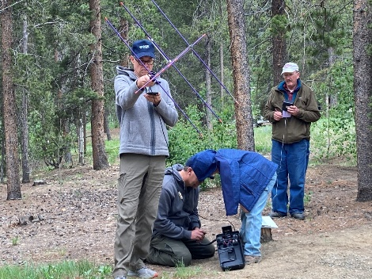
Field Day 2023
Saturday, June 24 – Sunday, June 25
Noon-noon
Objective
To work as many stations as possible
ARRL: “…not contest…” (It sure feels like one)
Learn to operate in abnormal situations in less than optimal conditions
A premium is placed on developing skills to meet the challenges of emergency preparedness as well as to acquaint the general public with the capabilities of Amateur Radio.
Club members not at the site can still add their score to WØNED!
Use your own call
Enter WØNED on submission form

Slide 7
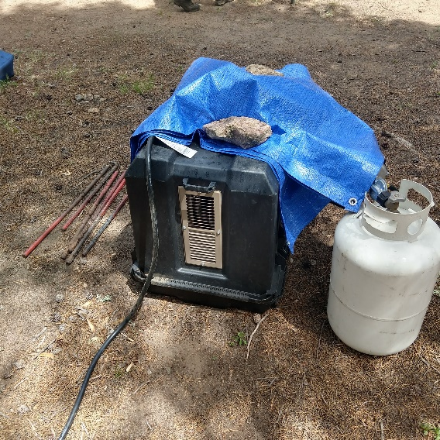
Field Day 2023
Class Discussion
Class A Club / non-club portable: Club or a non-club group of three or more persons set up specifically for Field Day. All contacts must be made with transmitter(s) and receiver(s) operating independent of commercial power.
Class D Home stations: Stations operating from permanent or licensed station locations using commercial power

Slide 8
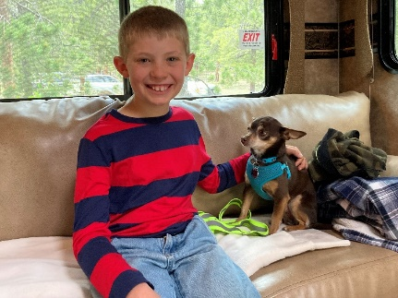
Field Day 2023
Headcount
Must have 3 transmitters on the air for a portion of the contest
40, 20, 15, 10, 6 meters
Can move around bands as needed
Must not be on same band, same mode, same time
Location
Golden Gate Canyon State Park
Use Gap Road Entrance for Reverand’s Ridge Campground; Site 24; Loop B
Fee $10
Start setup Friday, 6/23
…tying off to trees is prohibited…
Supports for wire antenna ends?

Slide 9
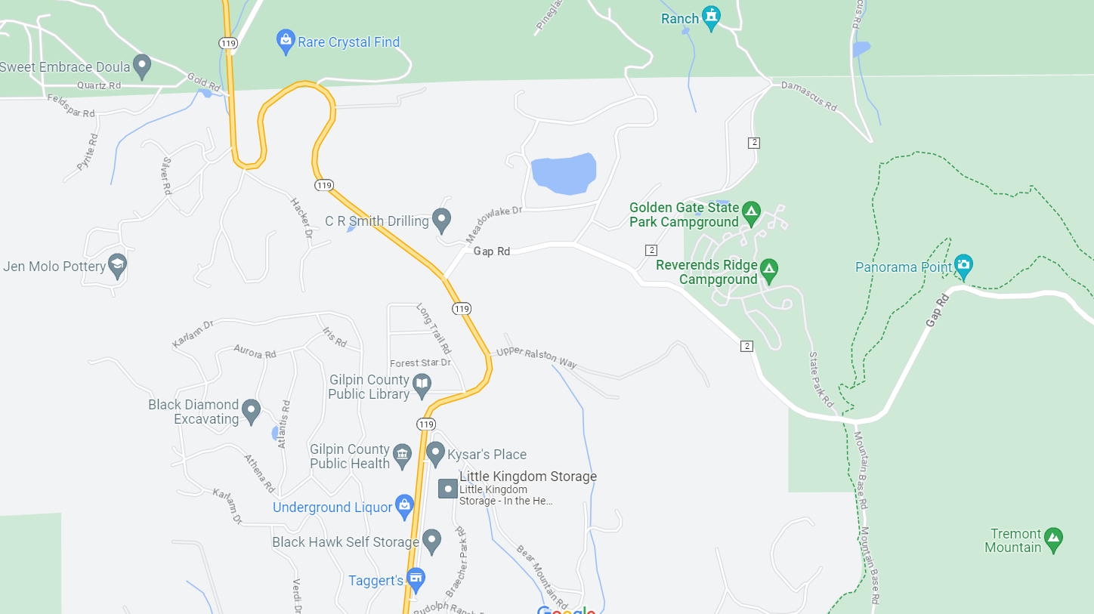
Field Day 2023 Golden Gate Canyon State Park
Lat 39.87612
Long -105.44963
Campground
(Park Fee $10)
Access from 119 to
Gap Road
Some Cell
Phone Coverage
No RVs on
Mountain Base Road

Slide 10
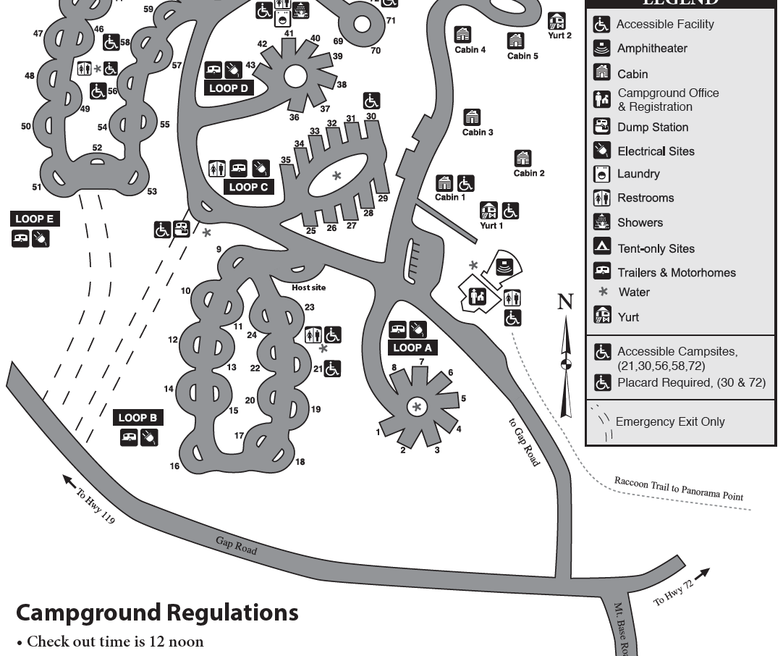
Field Day 2023
Site 43
Rick
Site 24
Scott & Debbie

Slide 11
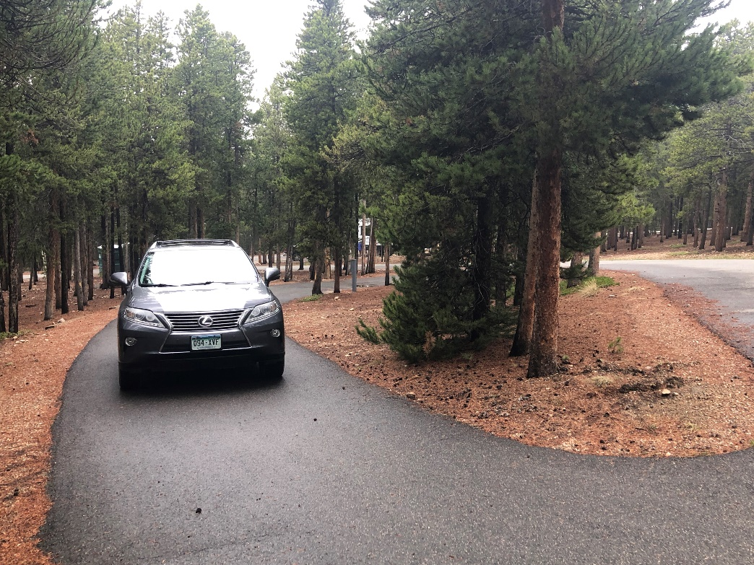
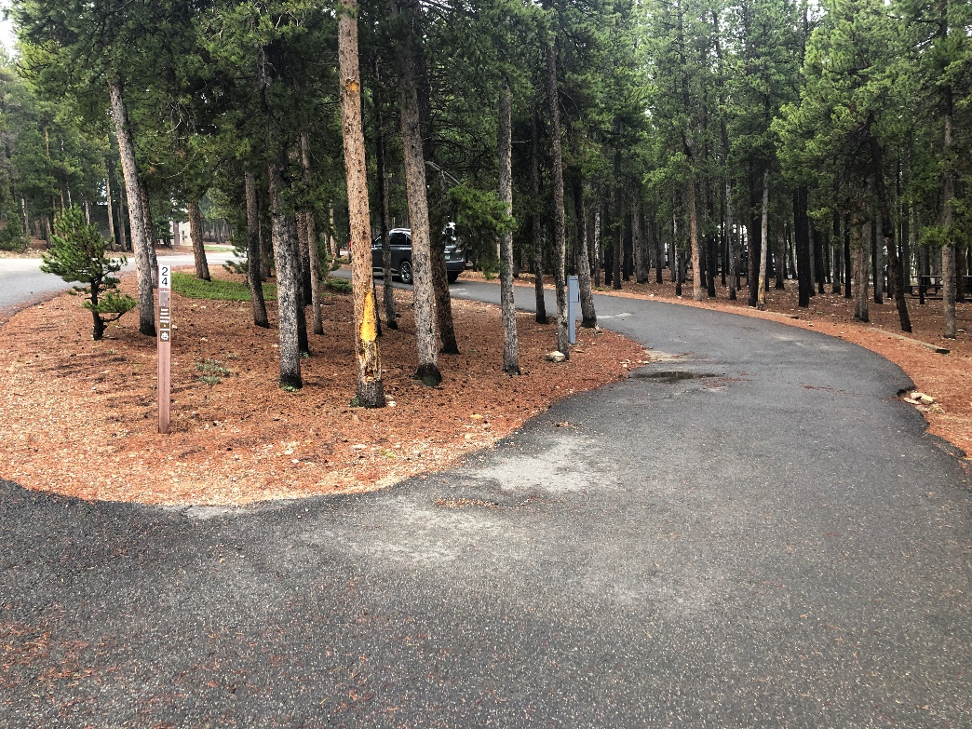
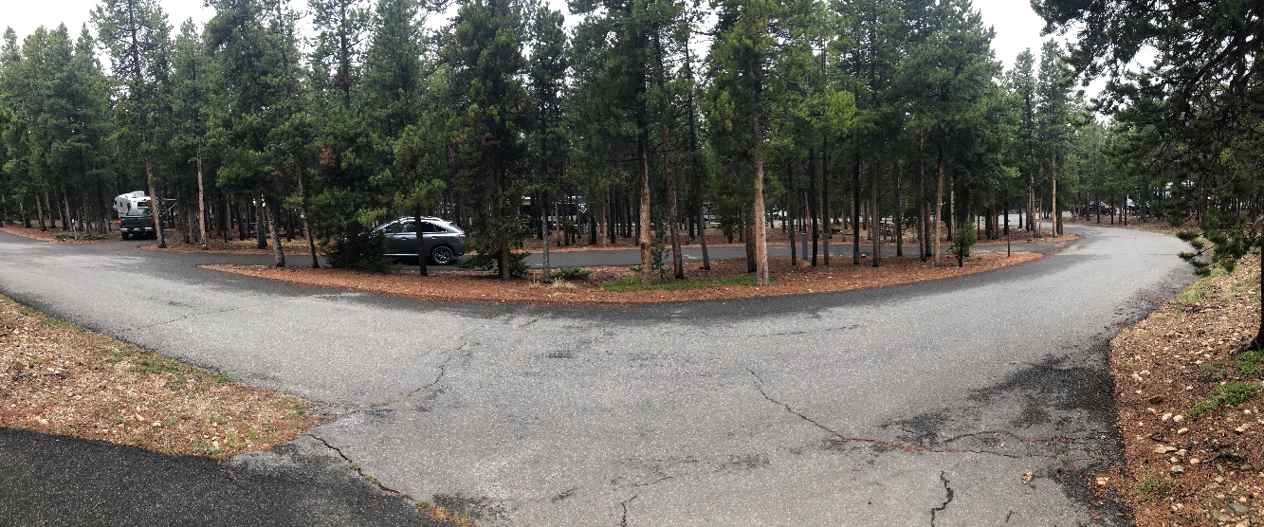
Field Day 2023; Site 24

Slide 12
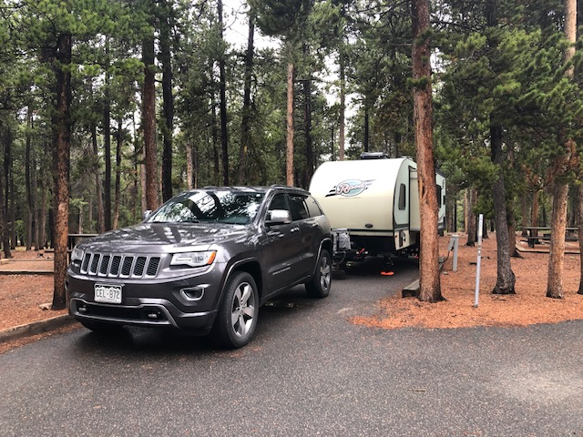
Field Day 2023; Site 43

Slide 13
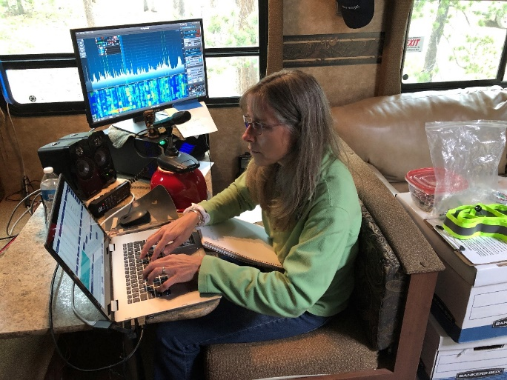
Field Day 2023
Campground Facilities
RV and tent(s) at each site
Restrooms
120V power pole
Showers
Take into account
No cell service at site 24
Limited at Panorama Point
We will have neighbors (batteries at night?)
We will have neighbors (promote ham radio!)

Slide 14
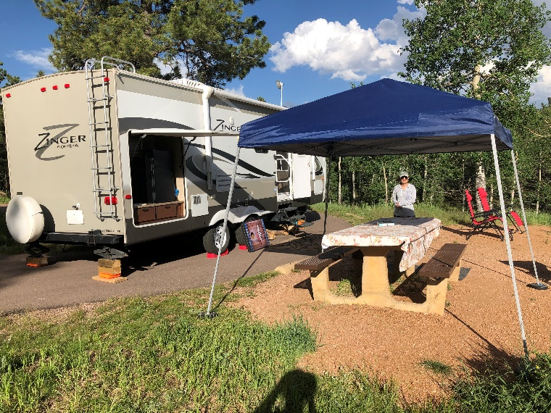
Field Day 2023
We have a 30’ trailer available with extra bed
Generator with quiet enclosure
FT-847 and Flex-6400
Hamstick antennas, 20m dipole off-center fed multi-dipole
Moxon – Charlie?
Other Rigs / Antennas?
Power sources
Batteries, batteries, batteries
Solar for bonus?
Need CW Operators!
2 points/contact vs. 1 for phone!
Sign up Google Doc
Food Plan
Log using N3FJP Program
Club call, PW 35350
Talk-In WØNED repeater – confirmed coverage!
Simplex (146.500)

Slide 15
Bonus Points (need owners)
Attempt 2023
100 pts/xmtr 100% Emergency Power 300 total
100 points Media Publicity (Actual – changed from 2022)
Omayra from Mountain Ear plans attending
100 points Public Location
100 points Public Information Table
100 points Message Origination to Section Manager
10 pts/message Message Handling?
100 pts Satellite QSO
100 points Alternate Power (5 QSOs, can be battery charge)
100 points W1AW Bulletin Reception
100 points Educational Activity
100 points Site visit by elected official
100 points Site visit by ARES official
50 points Web submission
Up to 100 points Youth participation
100 points Social Media Promotion Facebook
100 points Safety Officer Debbie KFØIAJ

Slide 16
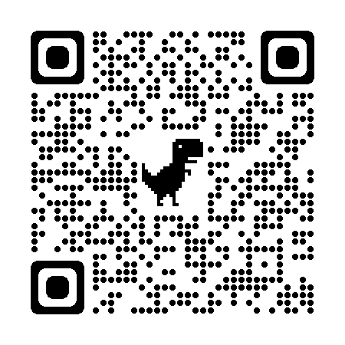
Attach to Club Banner (link to website)

Slide 17
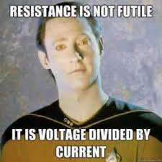
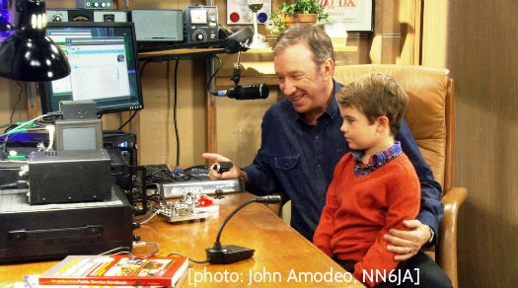
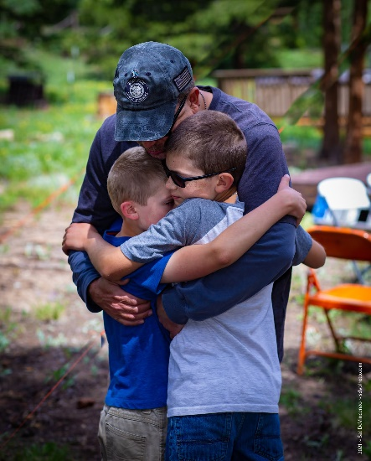
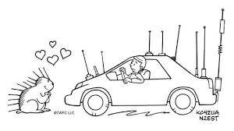
CQ Field Day!
More People = More Fun!
Come on out, if only for a while…

Slide 18
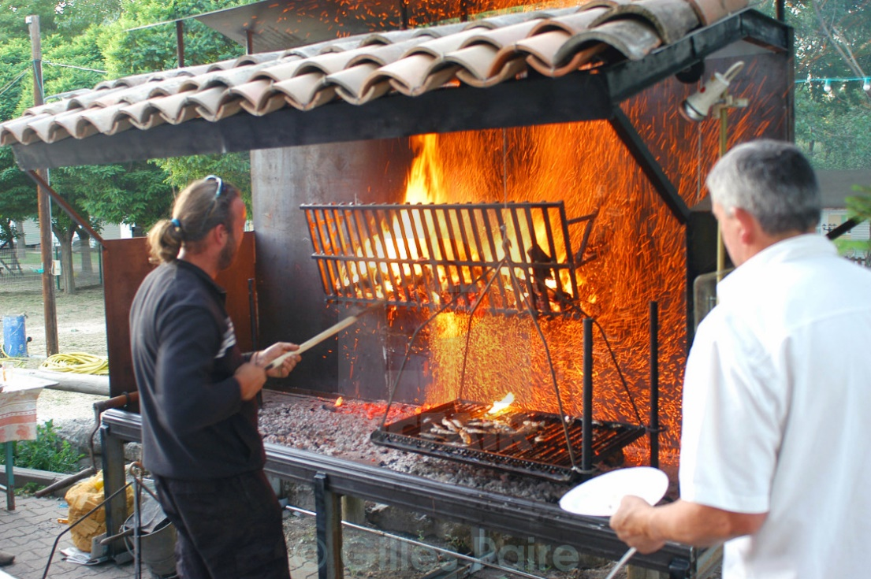
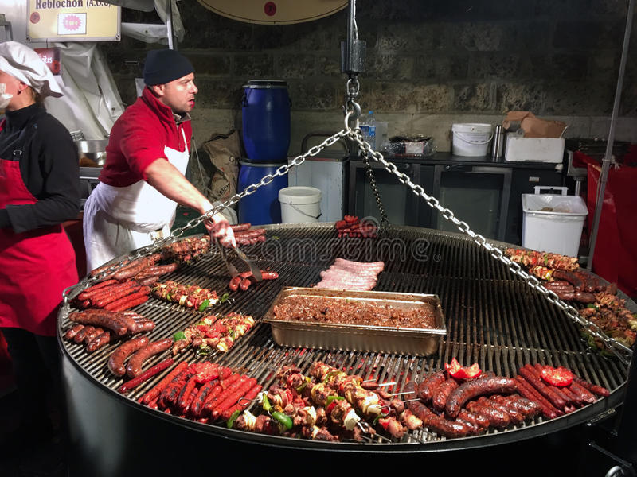
IPRC Party
Bar-K IPRC BBQ
This Summer
Details coming…

